Slide 1

Cloud Understanding
Dr. A. Suresh, INSOFE

Slide 2
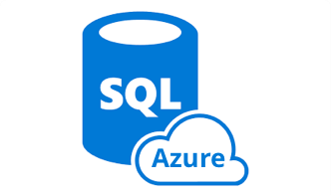

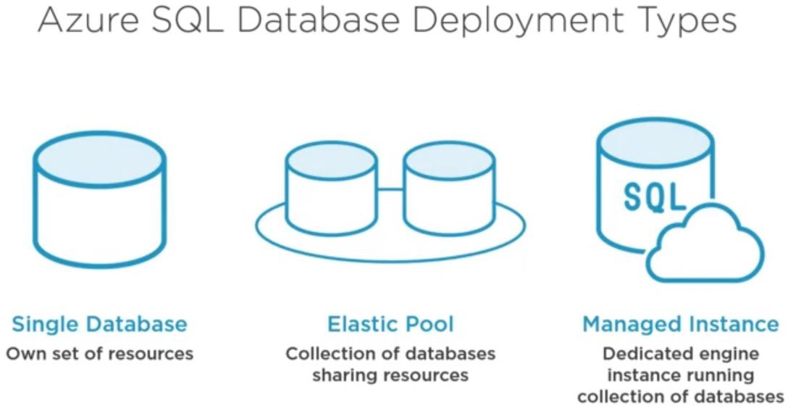
Introduction

Slide 3

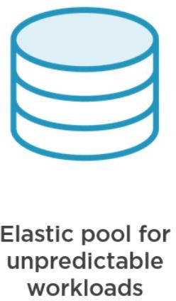



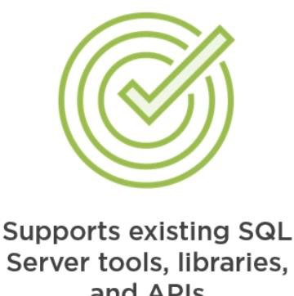
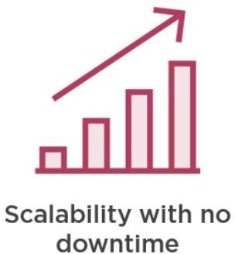

Why SQL Server in Azure?
Fully Managed

Slide 4
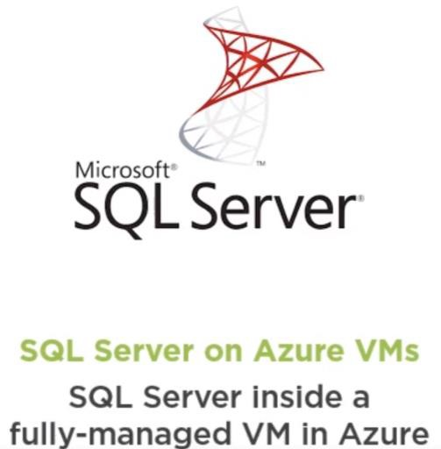
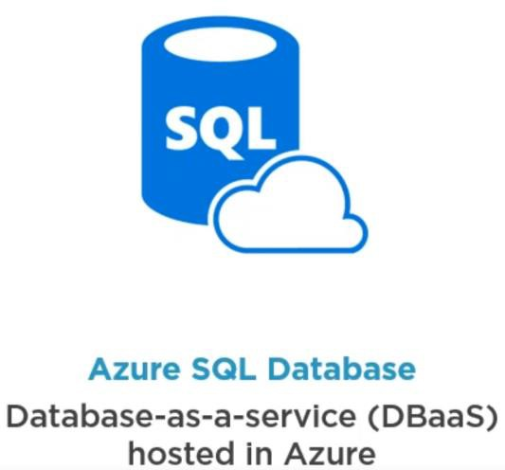
Azure IaaS vs PaaS Database offerings?

Slide 5
Responsibility comparison

Slide 6







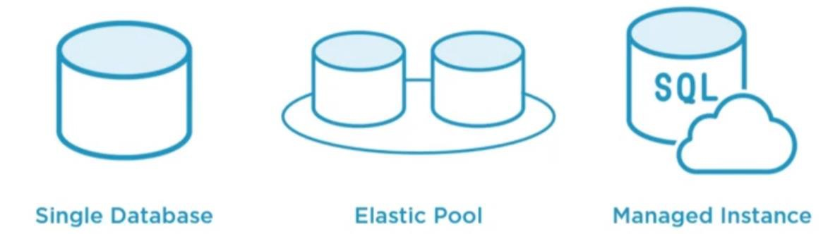
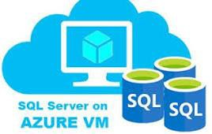


Azure Database Deployment options
Azure Database Offerings
PaaS
IaaS
Single Database
Elastic Pool Database
Managed Instance
SQL Server hosted on VM

Slide 7
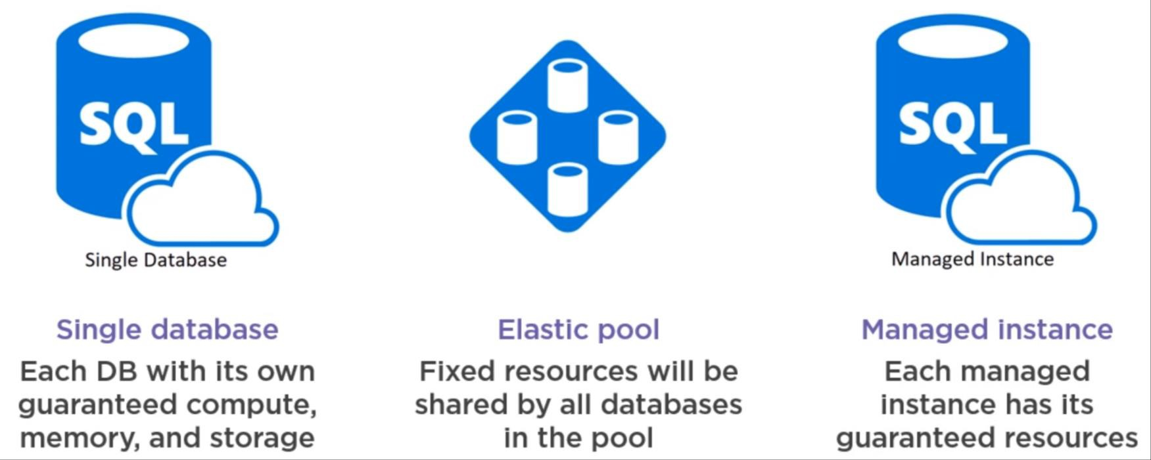
SQL Server(PaaS) Deployment Options

Slide 8
Azure Database Deployment options
Azure Database Offerings
PaaS
IaaS
Single Database
Elastic Pool Database
Managed Instance
SQL Server hosted on VM

Slide 9
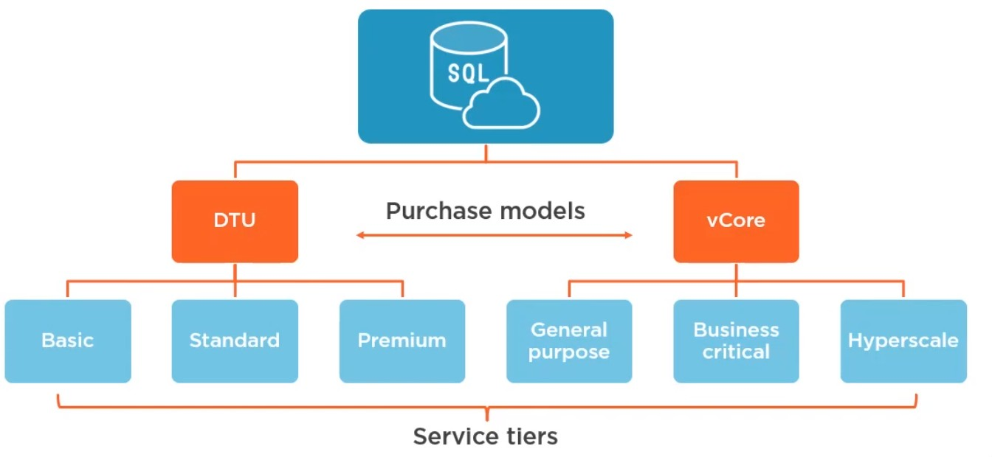
Azure SQL Database Service Tiers

Slide 10
vCore-based vs DTU-based Model
vCore-based DTU-based
Only for single database and elastic pool
Best for customers who want single,
preconfigured resource options
Might need to calculate the needed DTUs before migration
If the DTU-based purchasing model needs your performance and business requirements, you should continue using it.
For Single database, elastic pool and managed instance
Best for customers who need flexibility,
control, and transparency
Straightforward way to translate on- premises workload to the cloud
Microsoft recommends vCore-based
model

Slide 11
Converting DTU-based Model to vCore-based
If you single database or elastic pool consumes more than 300 DTUs, converting to the vCore-based model might reduce your costs
You can use API of your choice or Azure Portal to convert to vCore
based model with ‘no downtime’.
Azure SQL Database managed instance only supports vCore-based purchasing model.

Slide 12




Azure SQL Database Service Tiers

Slide 13





Azure SQL Database Options
Deployment options
Purchasing models
Service Tiers

Slide 14
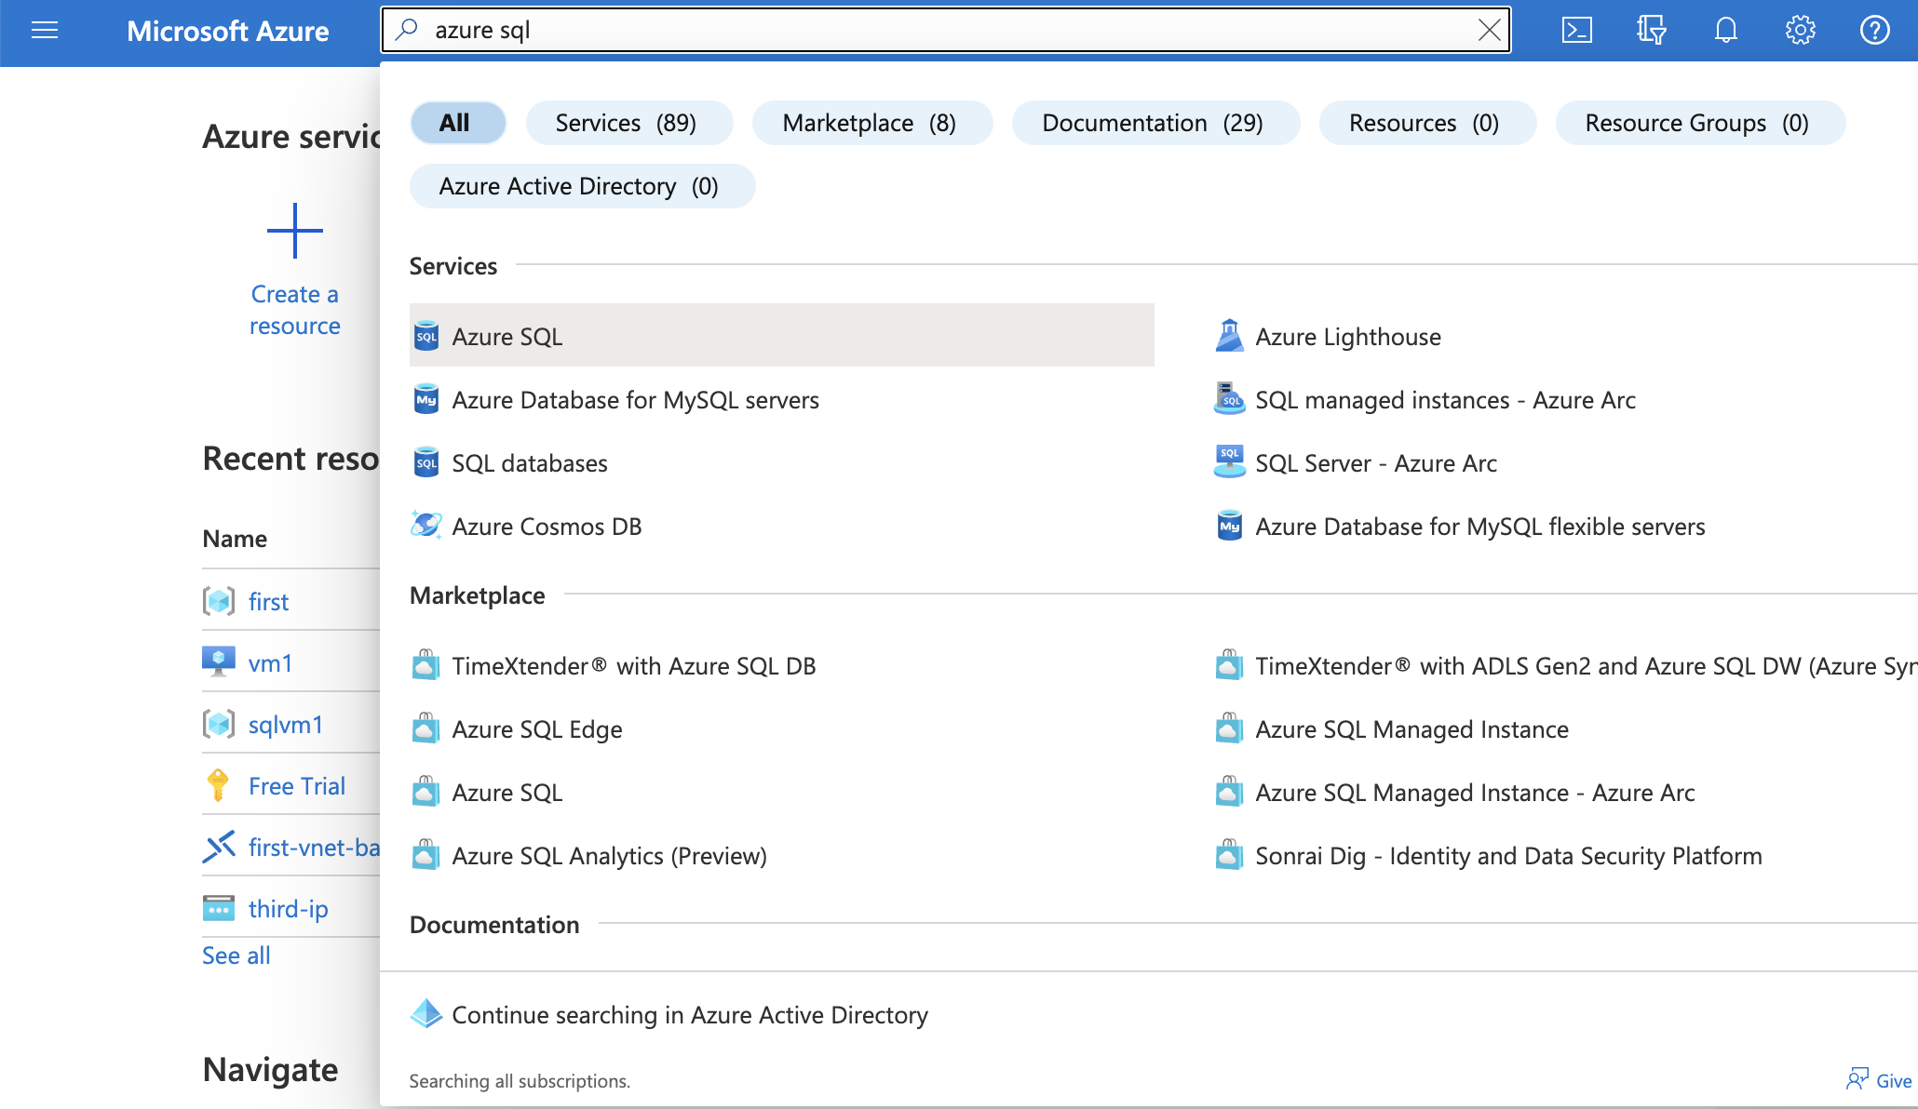
Creation of Single Database

Slide 15
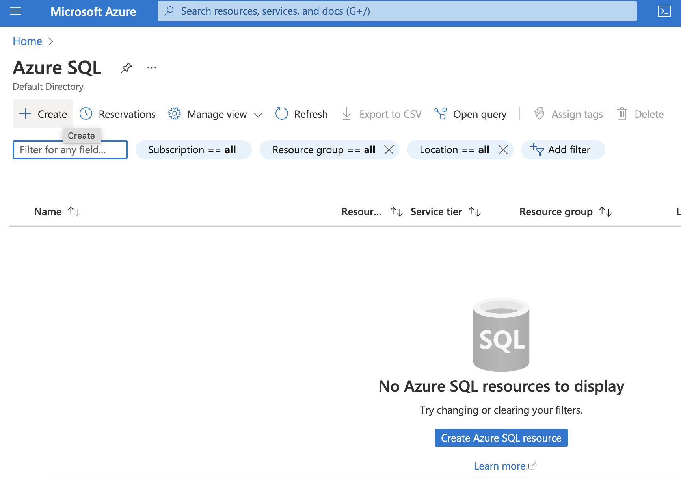
Creation of Single Database

Slide 16
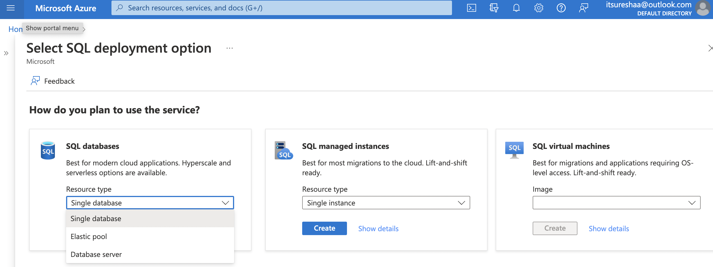
Creation of Single Database

Slide 17
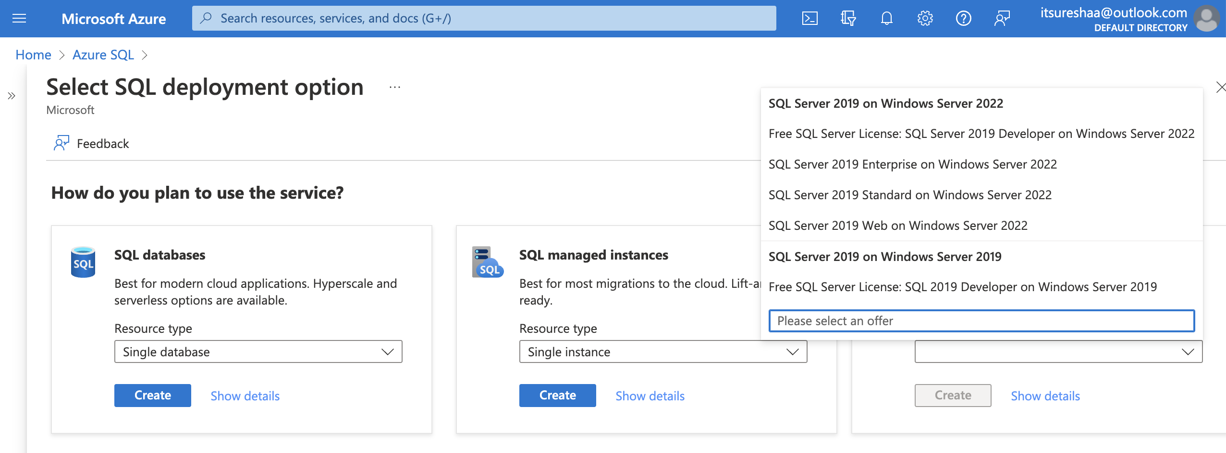
Creation of Single Database

Slide 18
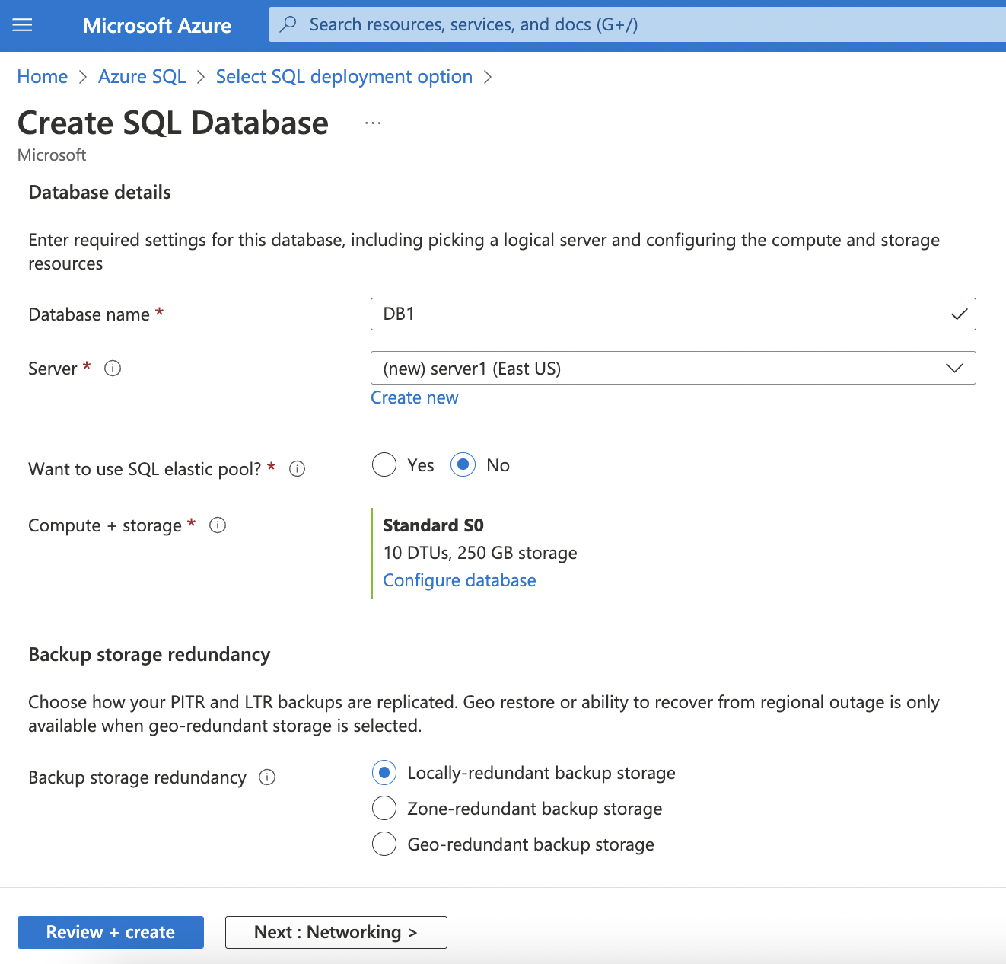
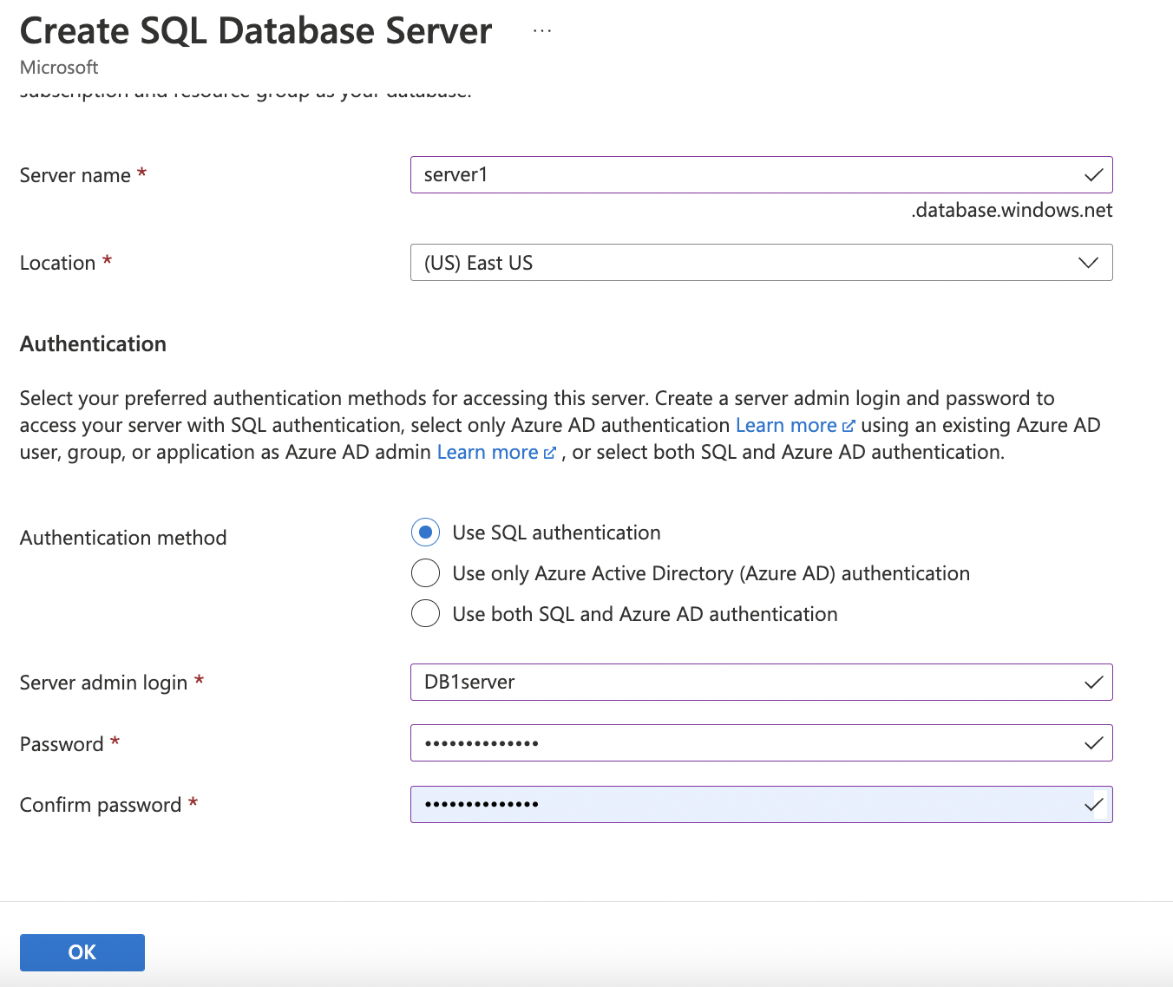
Creation of Single Database

Slide 19
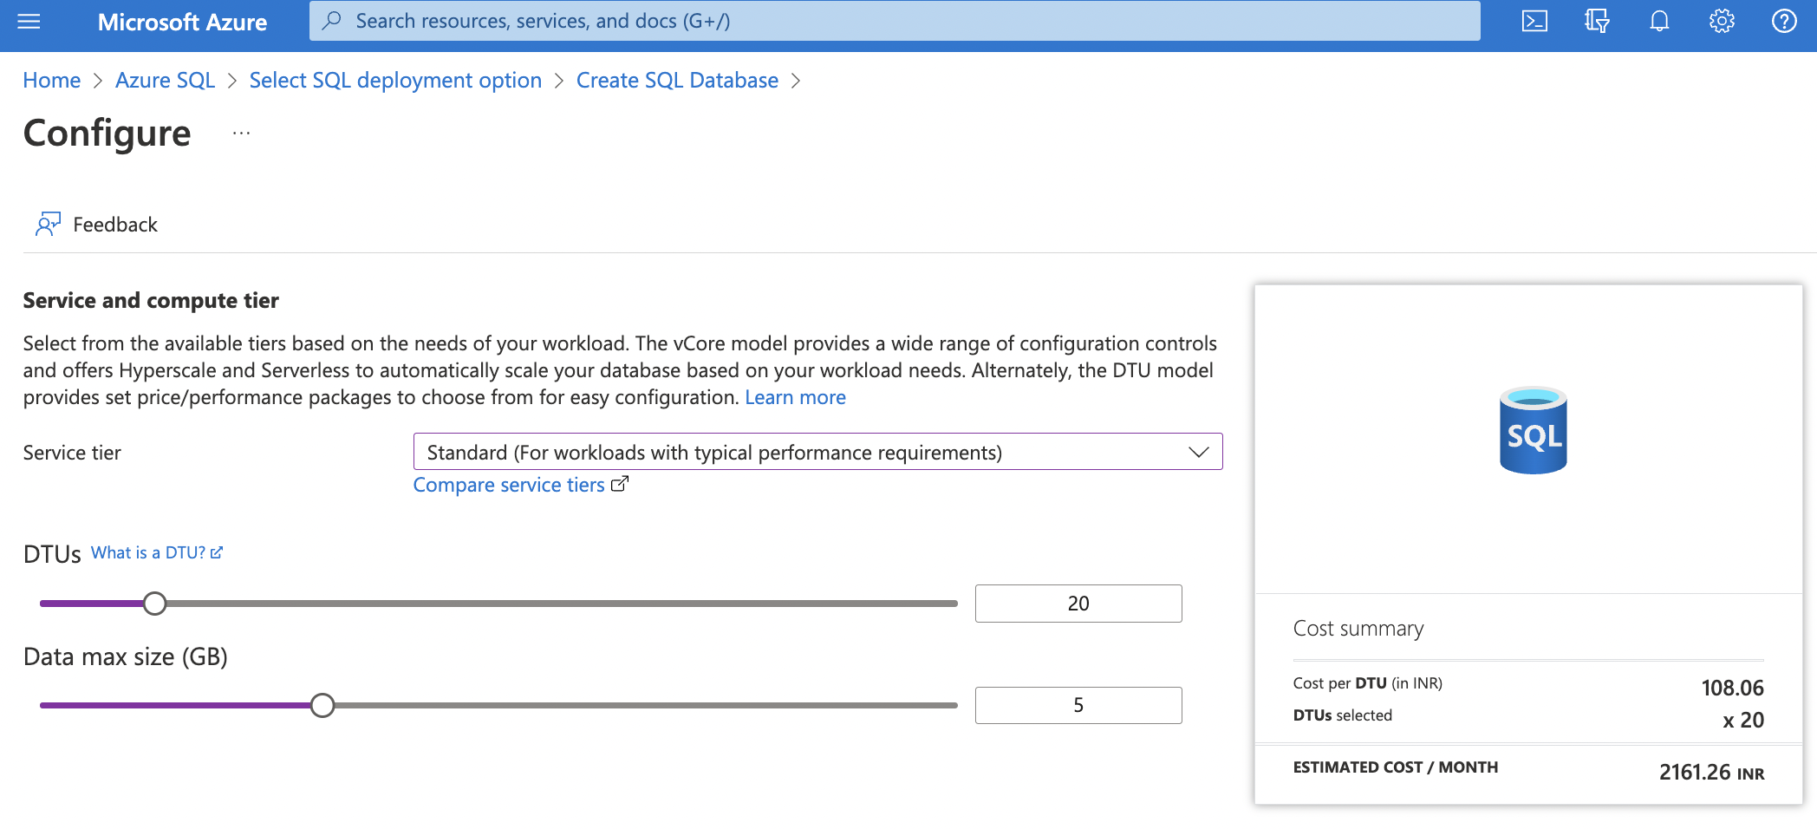
Creation of Single Database

Slide 20
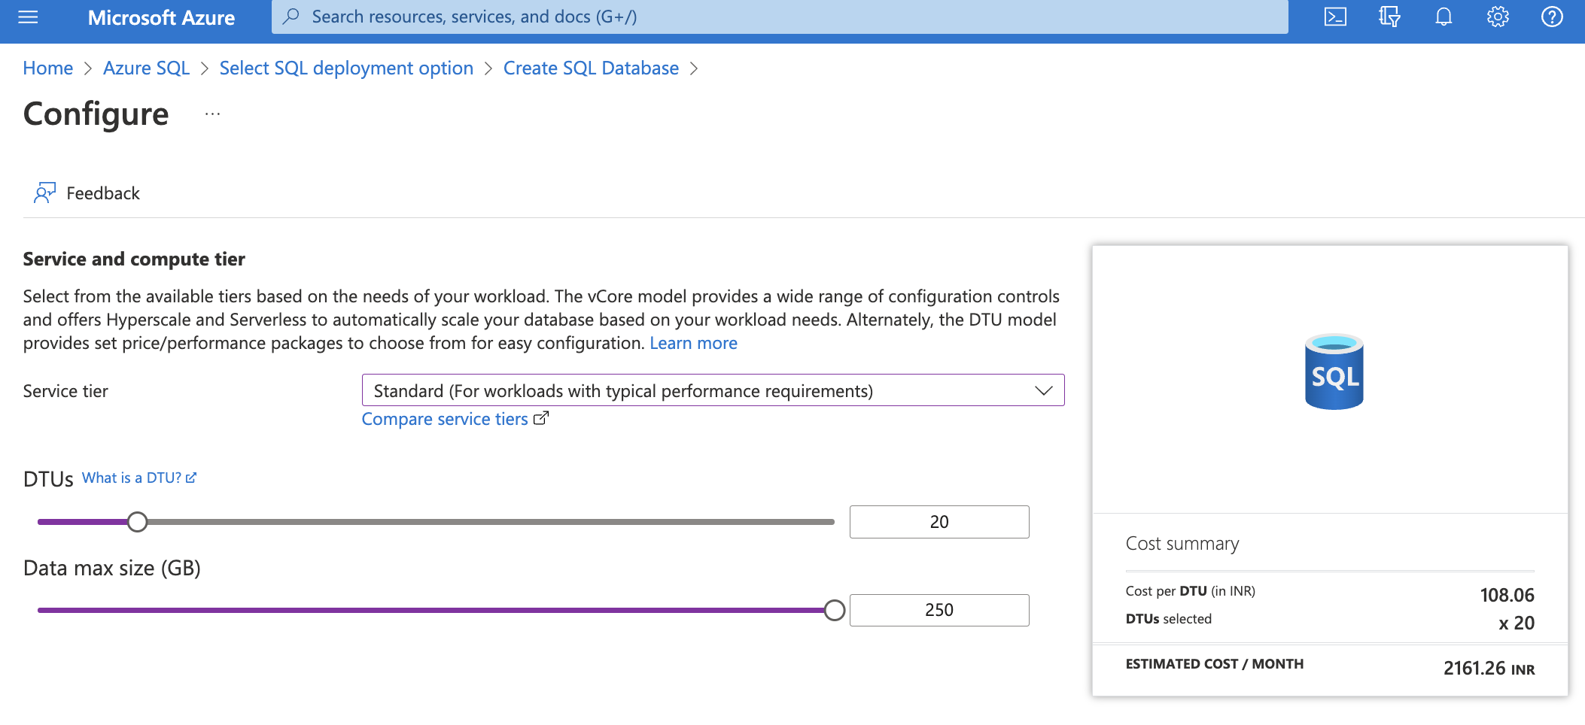
Creation of Single Database

Slide 21
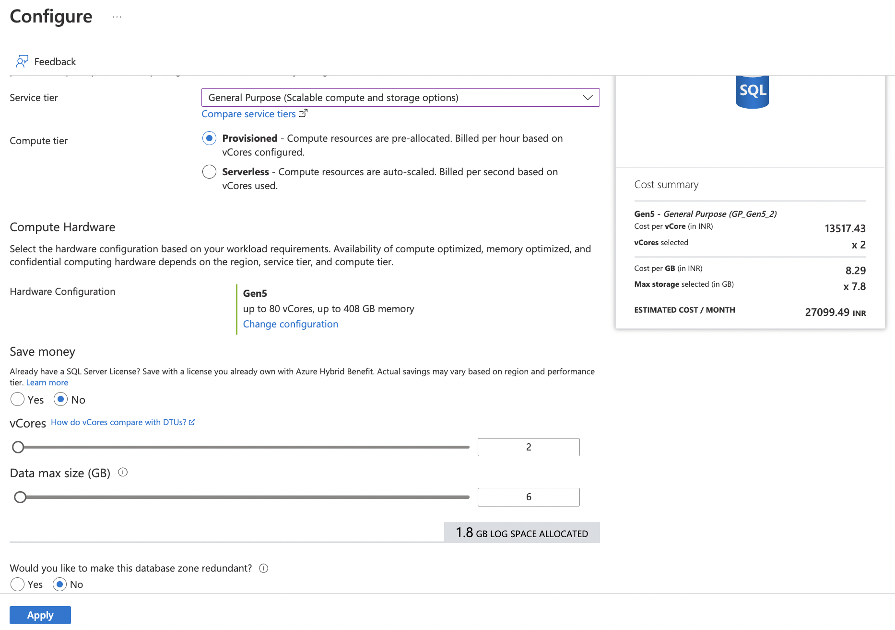
Creation of Single Database

Slide 22
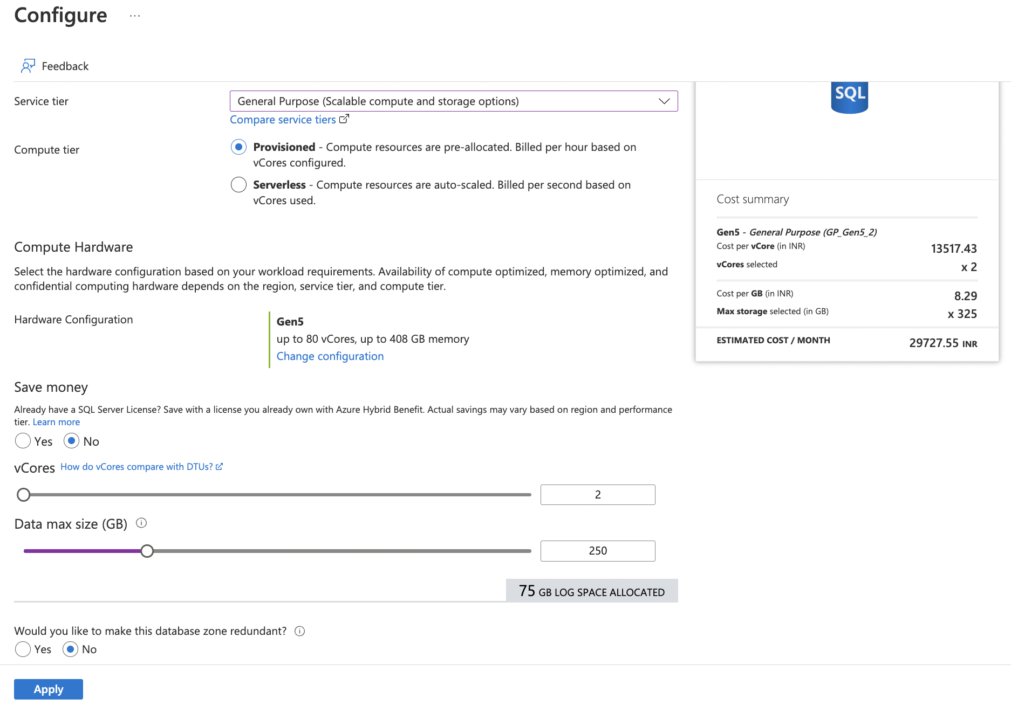
Creation of Single Database

Slide 23
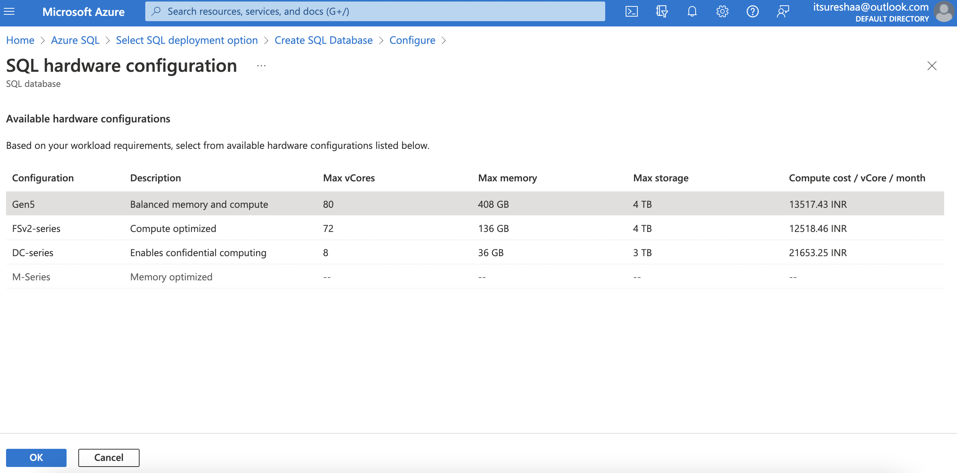
Creation of Single Database

Slide 24
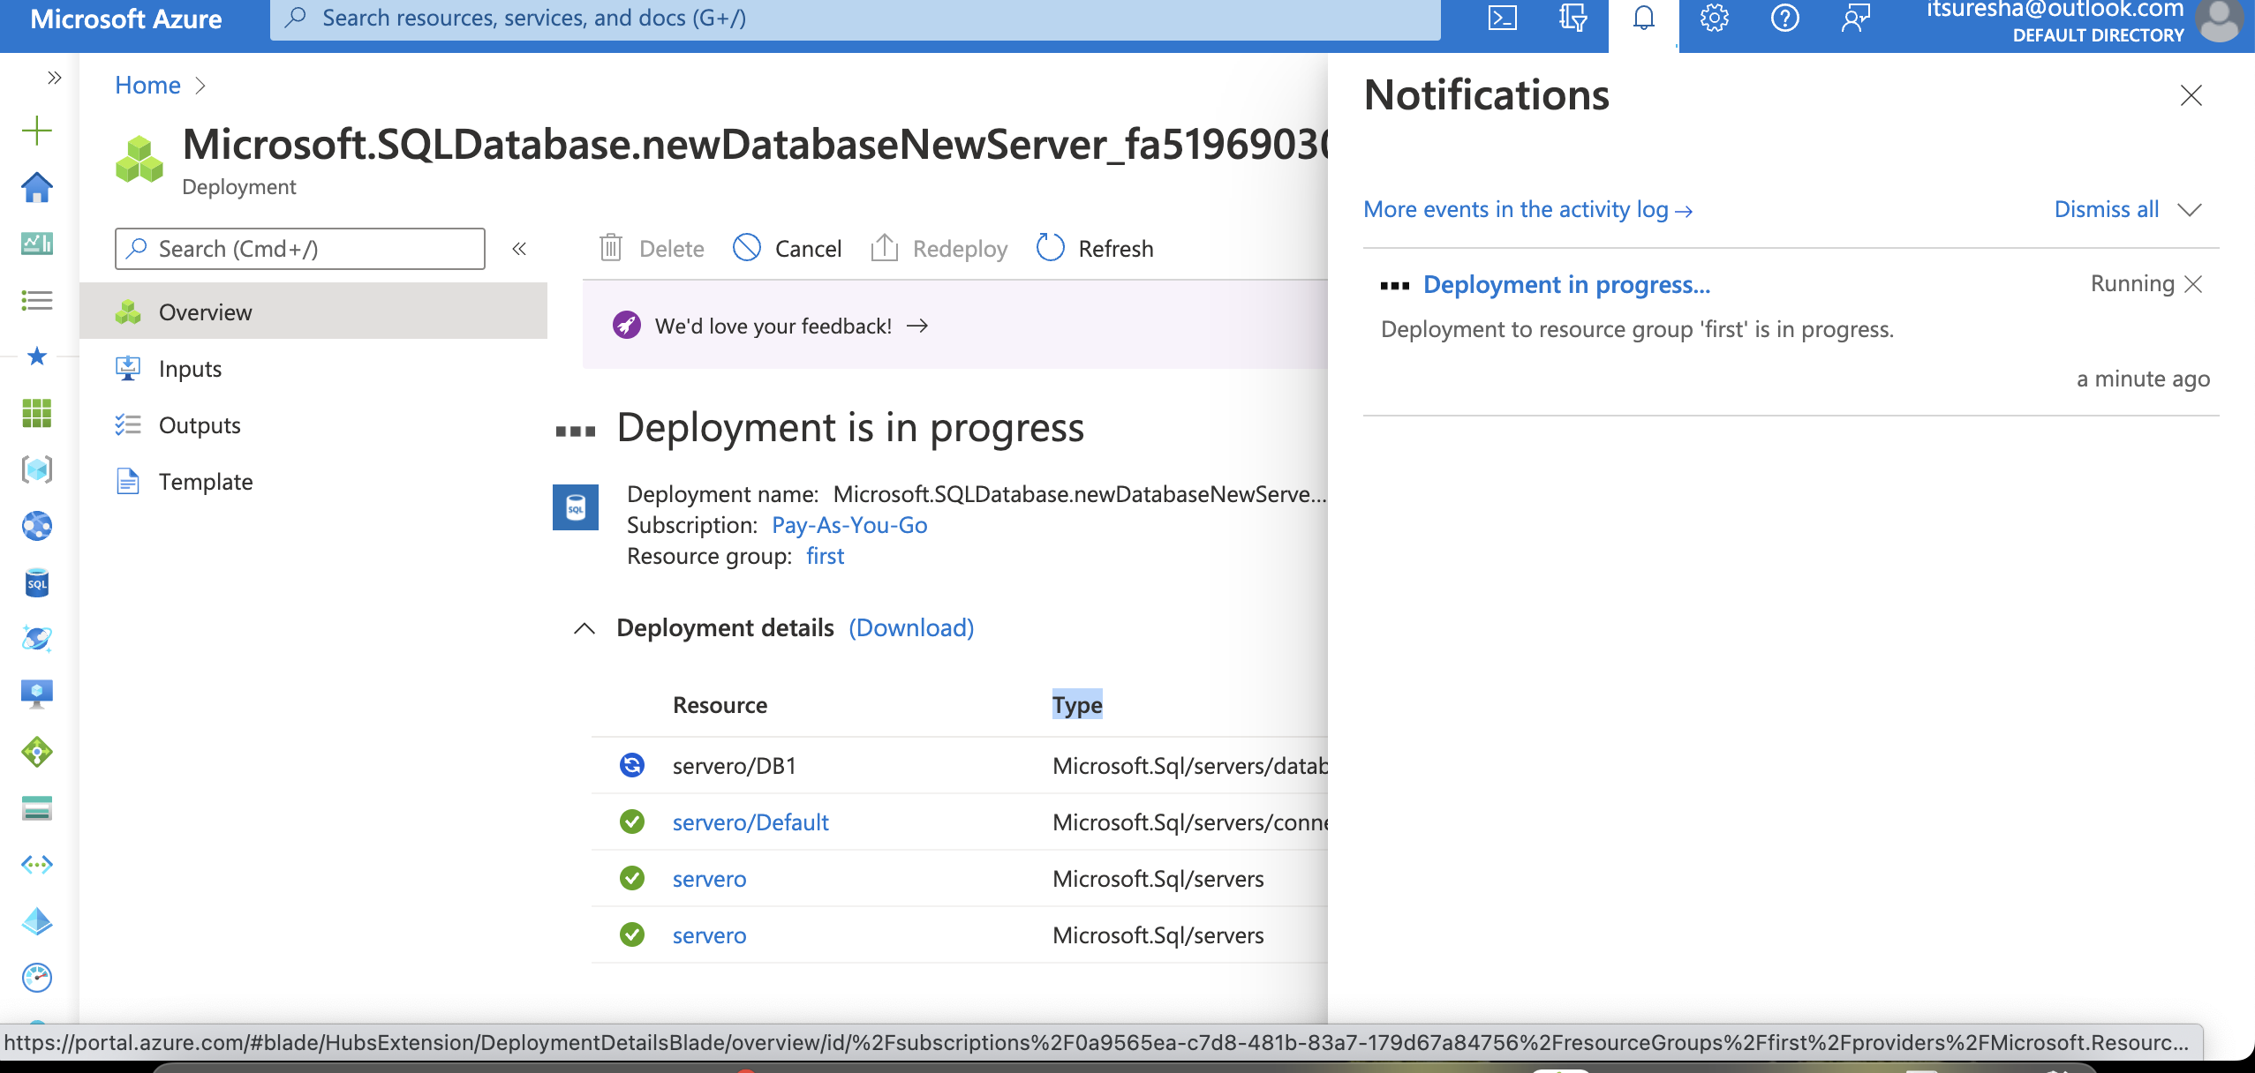
Creation of Single Database

Slide 25
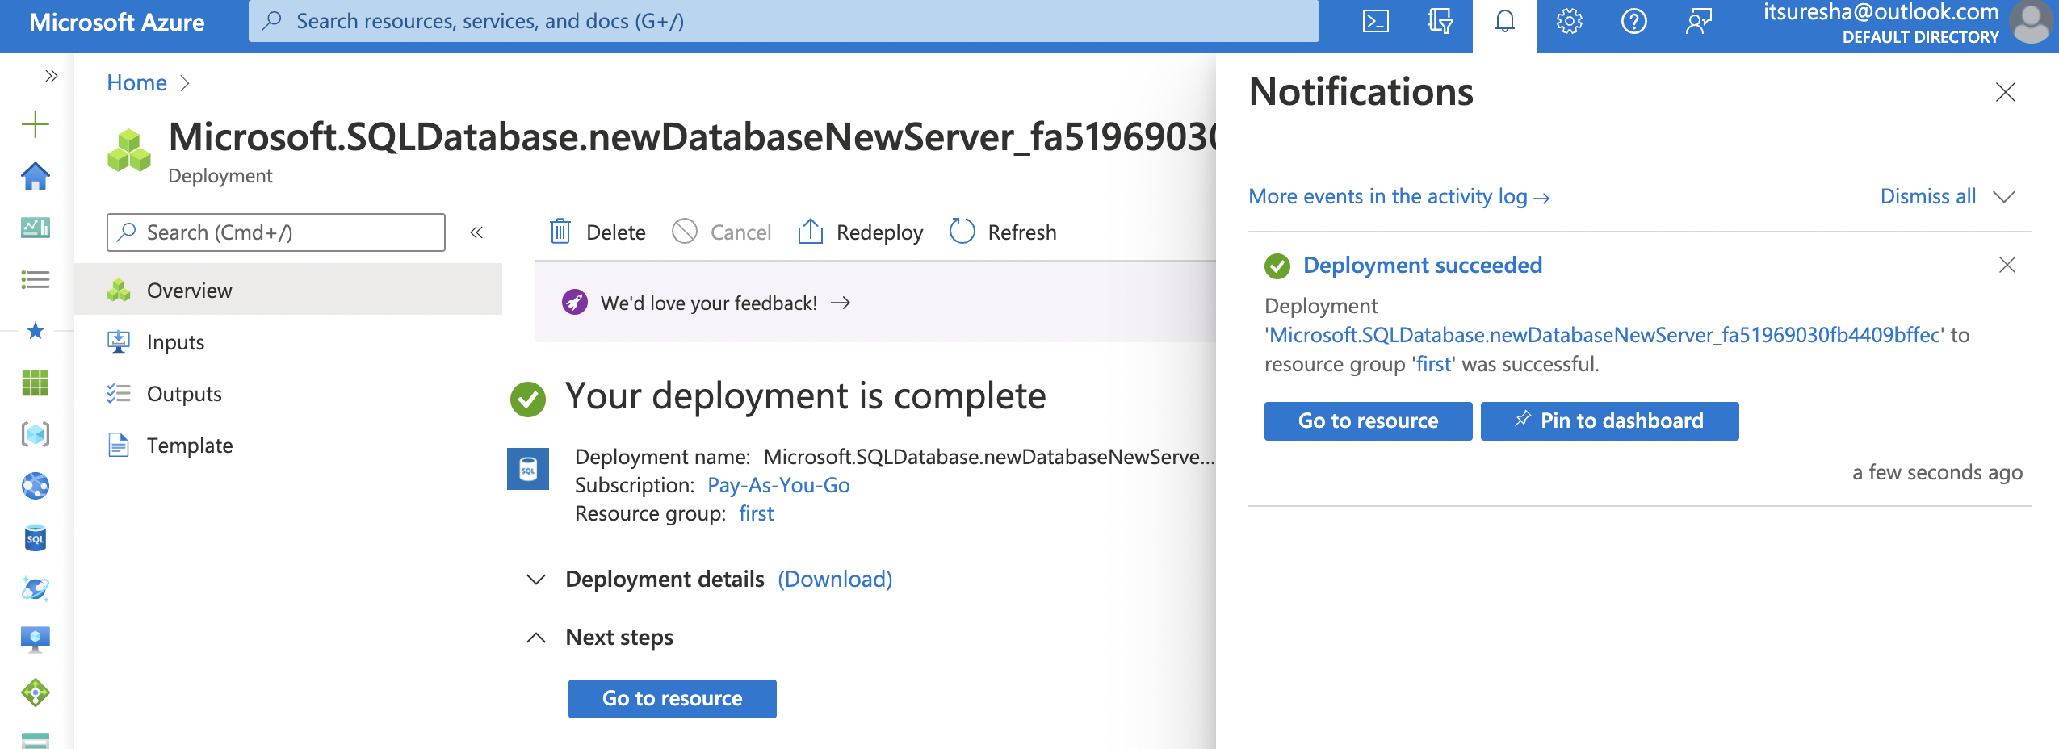
Creation of Single Database

Slide 26
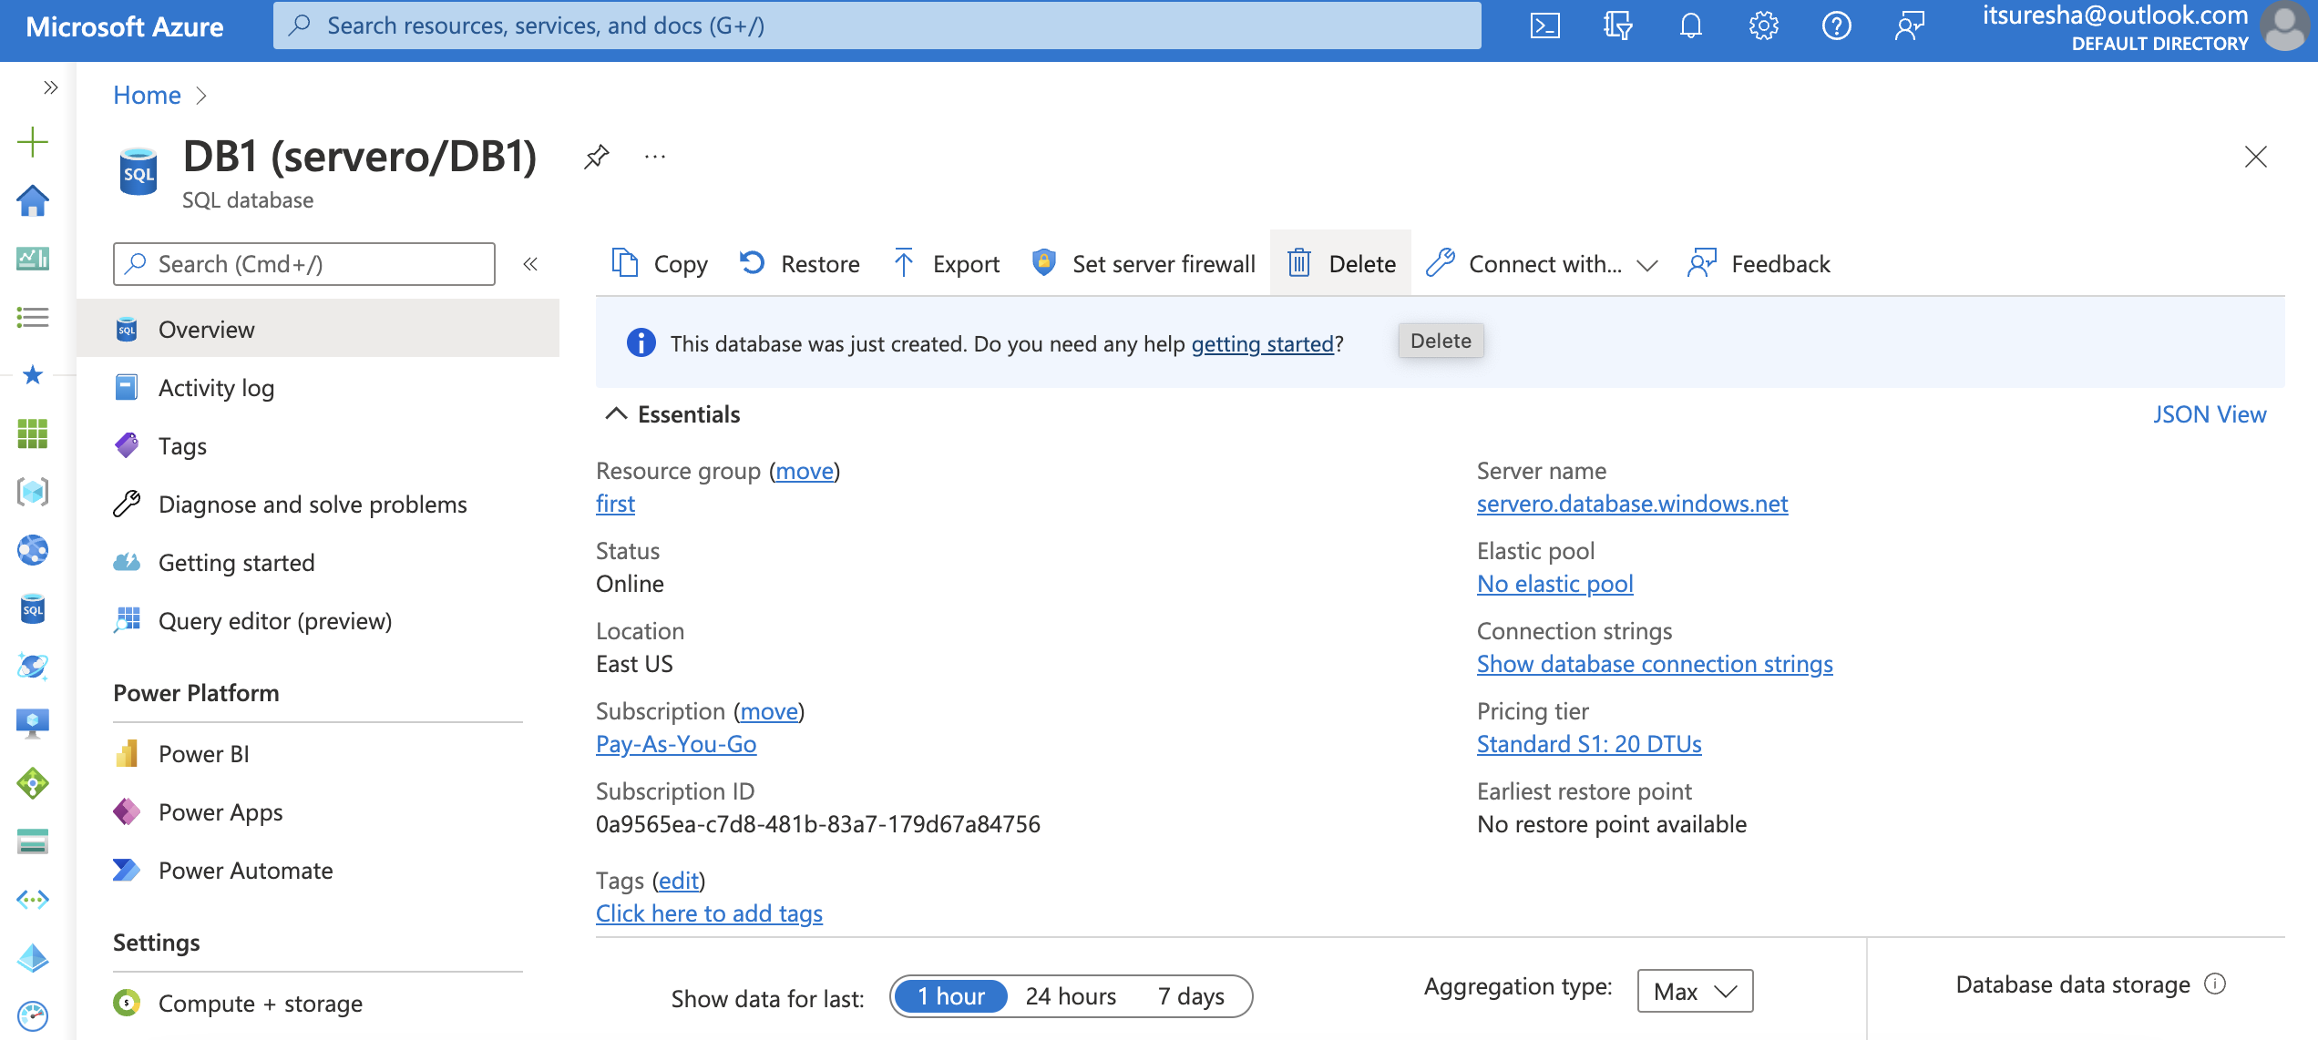
Creation of Single Database

Slide 27
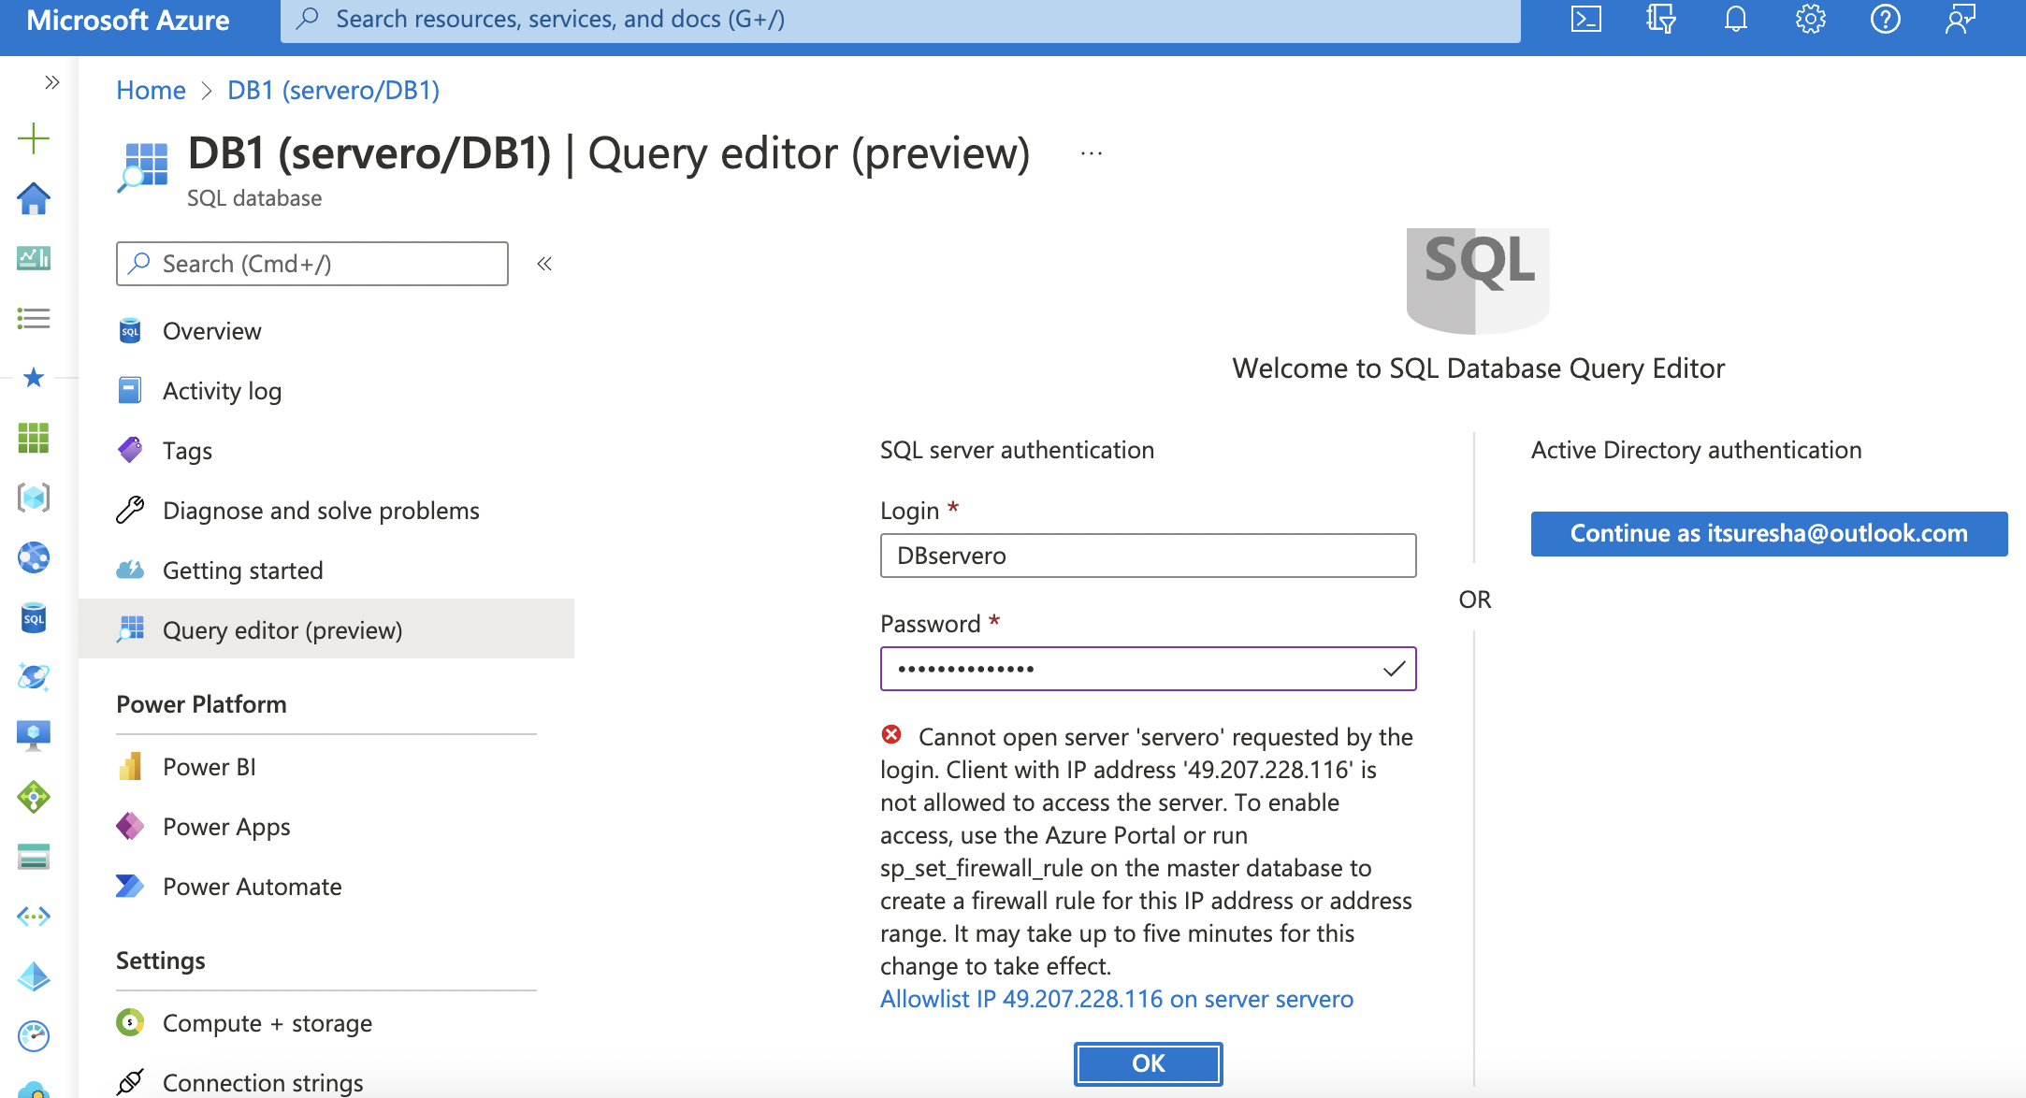
Creation of Single Database

Slide 28
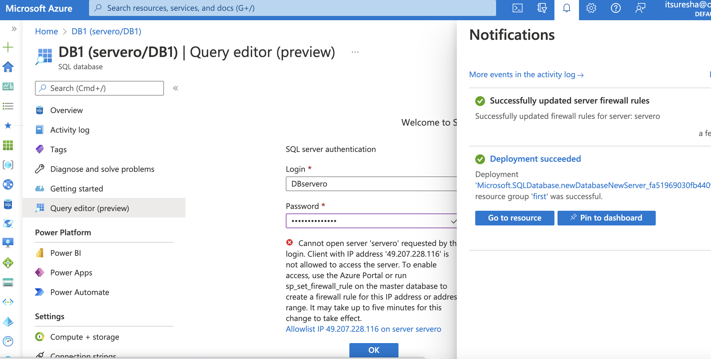
Creation of Single Database

Slide 29
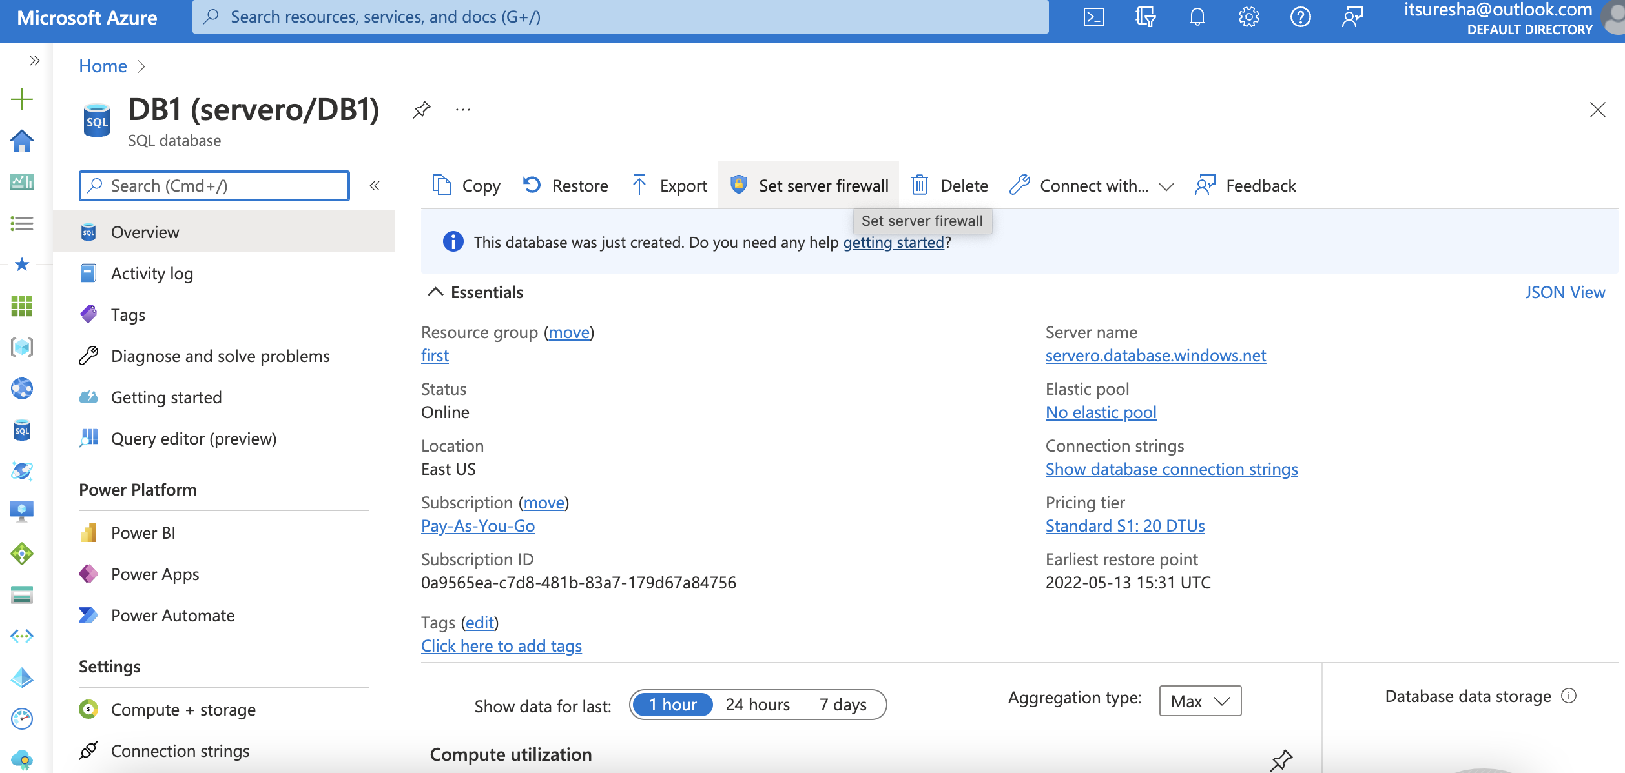
Creation of Single Database

Slide 30
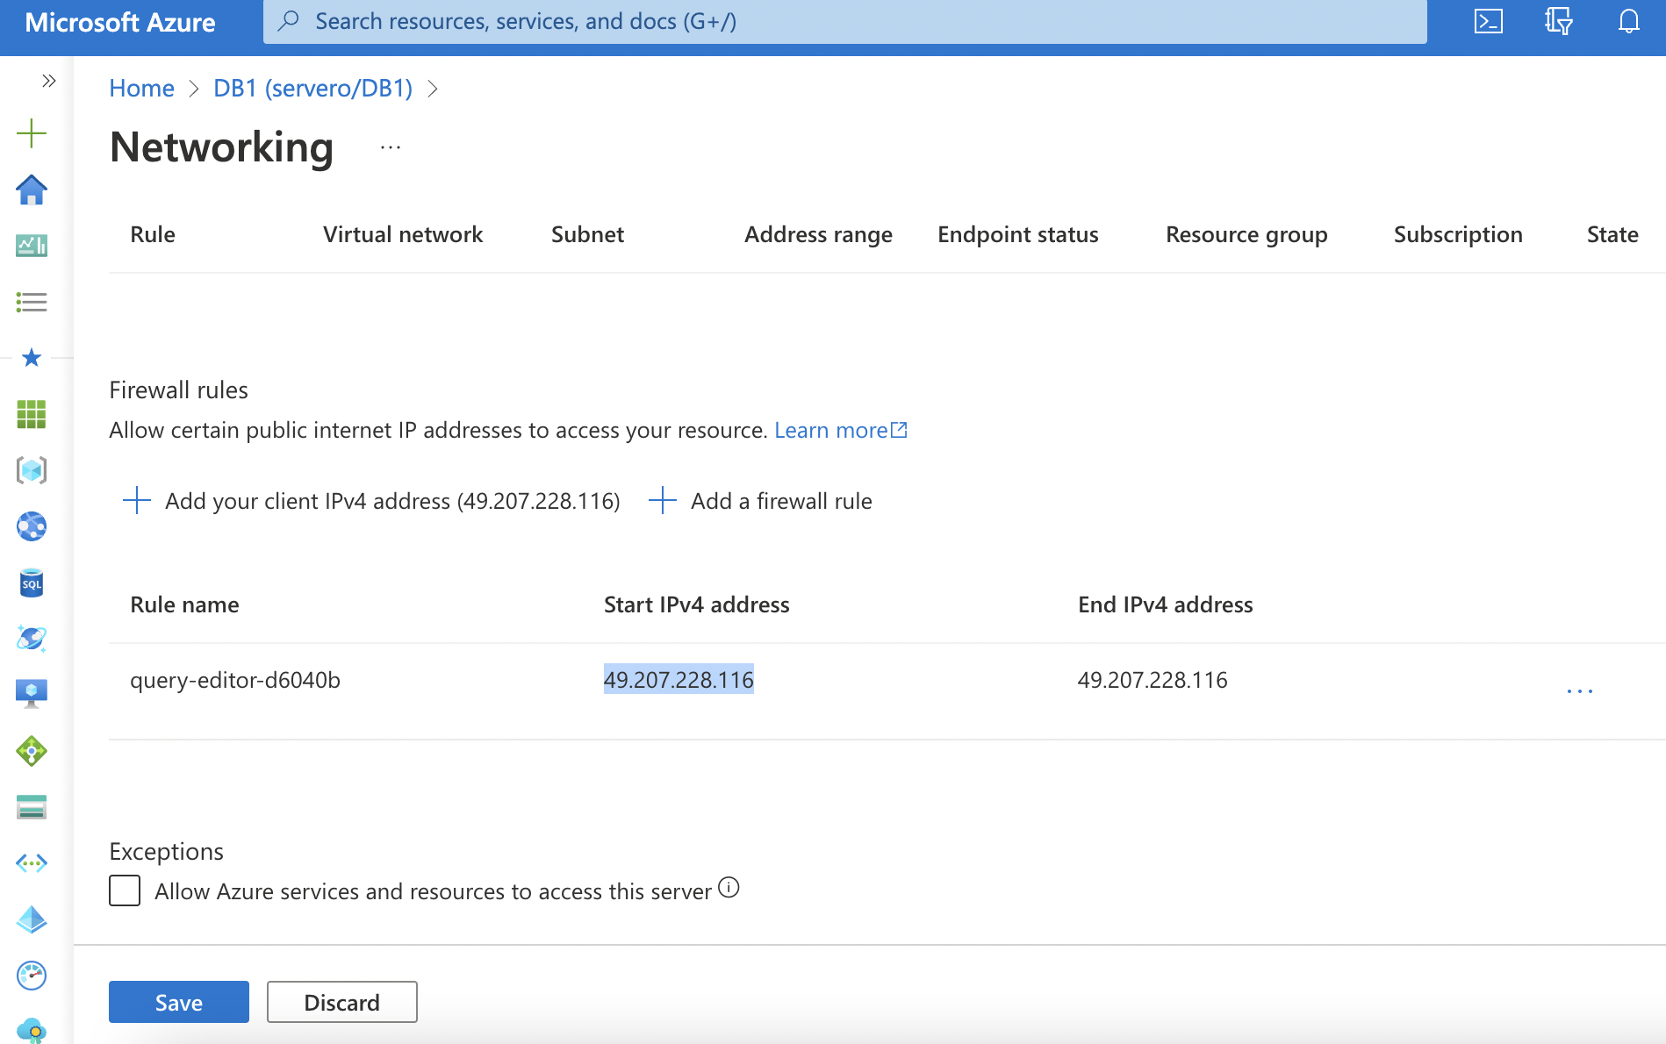
Creation of Single Database

Slide 31
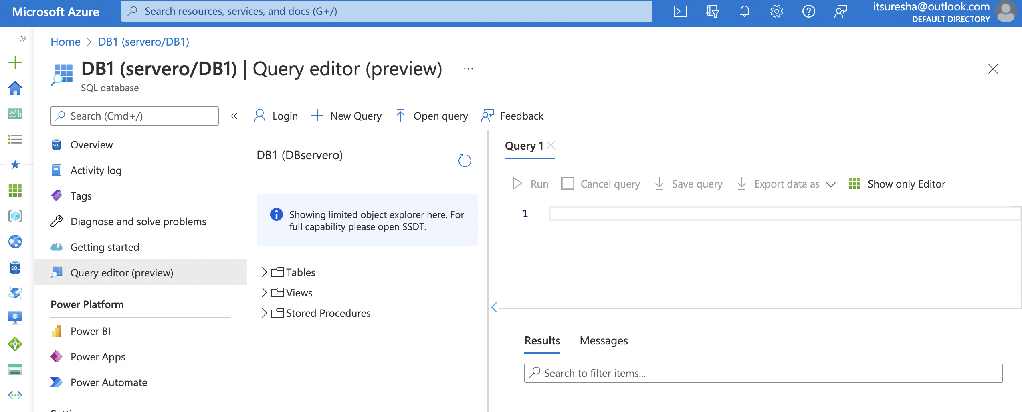
Creation of Single Database

Slide 32
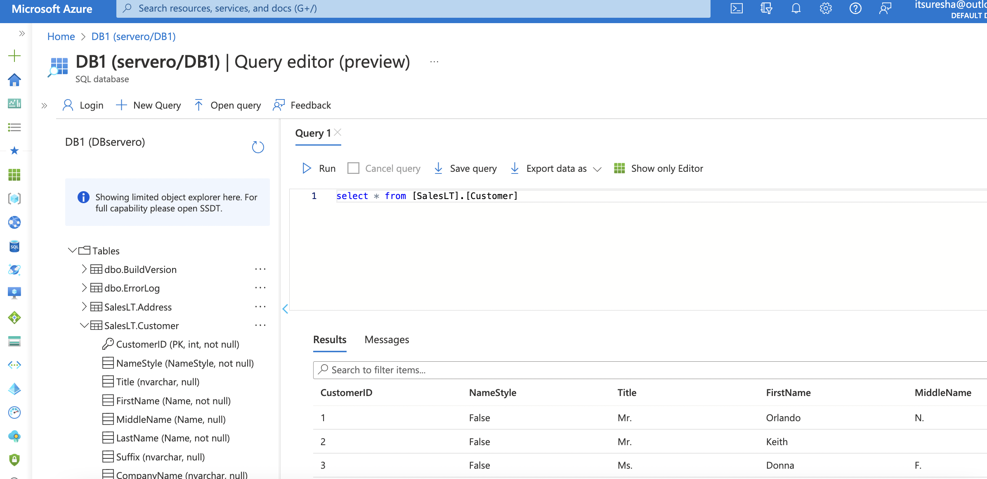
Creation of Single Database

Slide 33
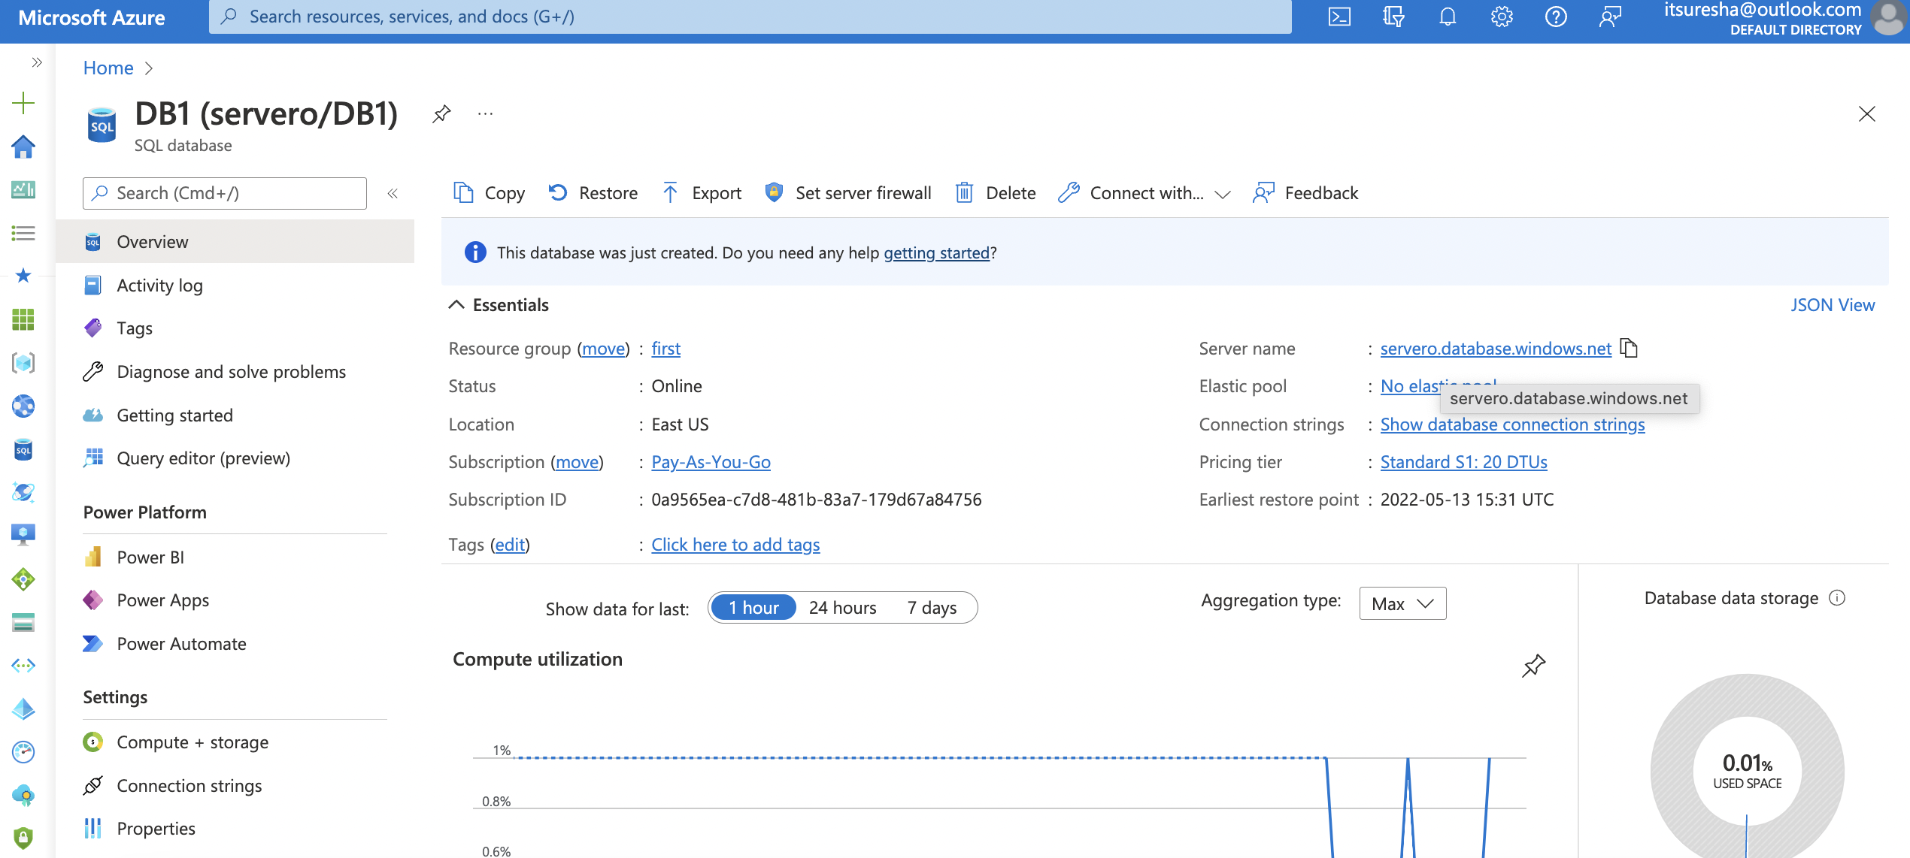
Creation of Single Database

Slide 34
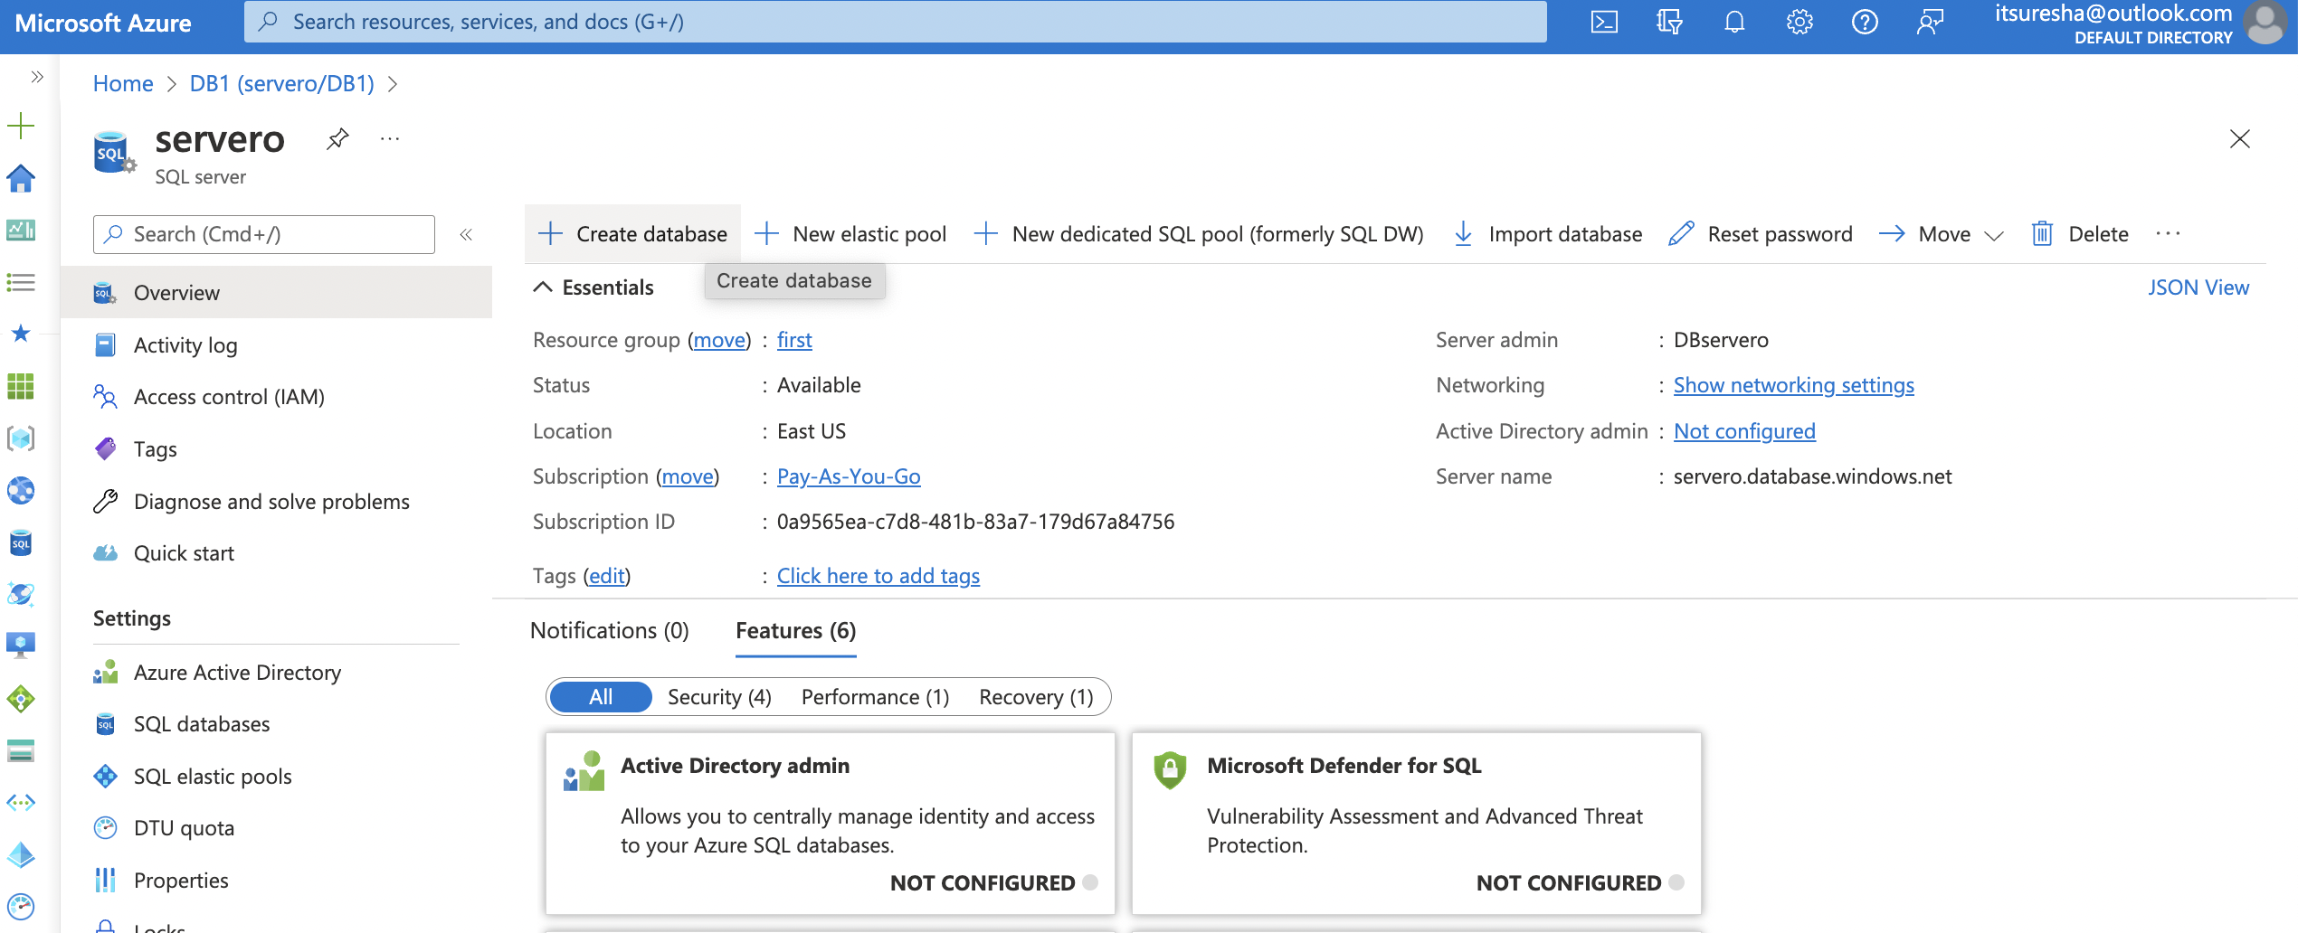
Creation of Single Database

Slide 35
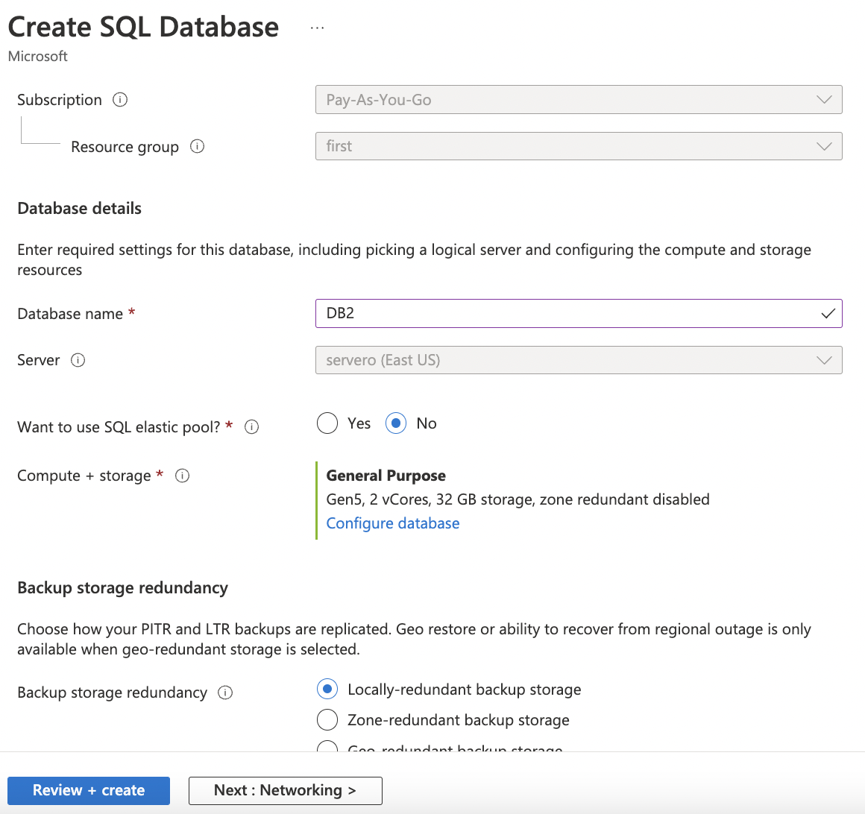
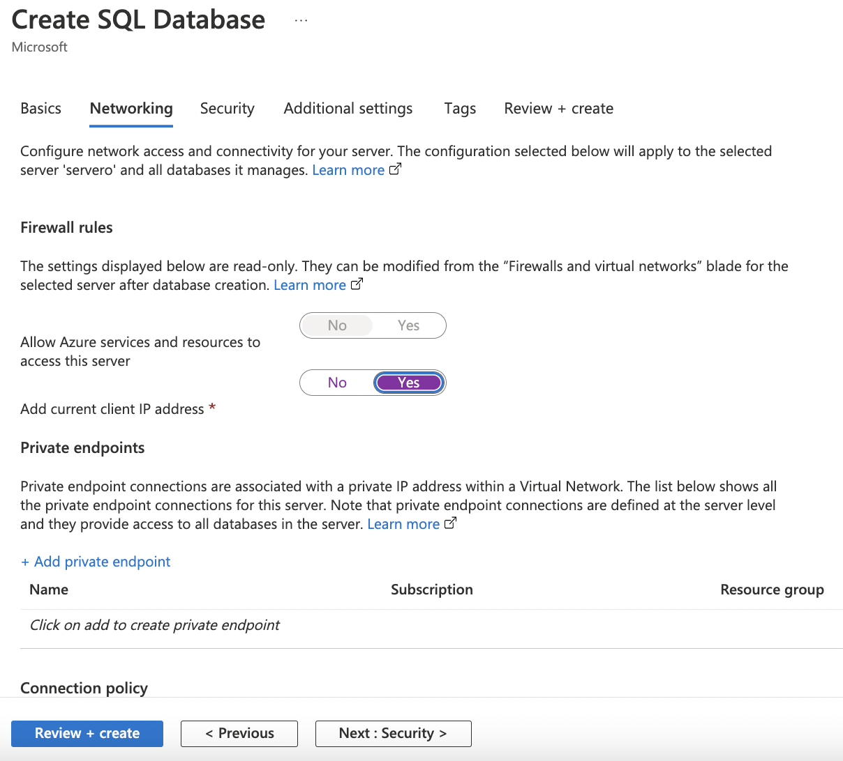
Creation of Single Database

Slide 36
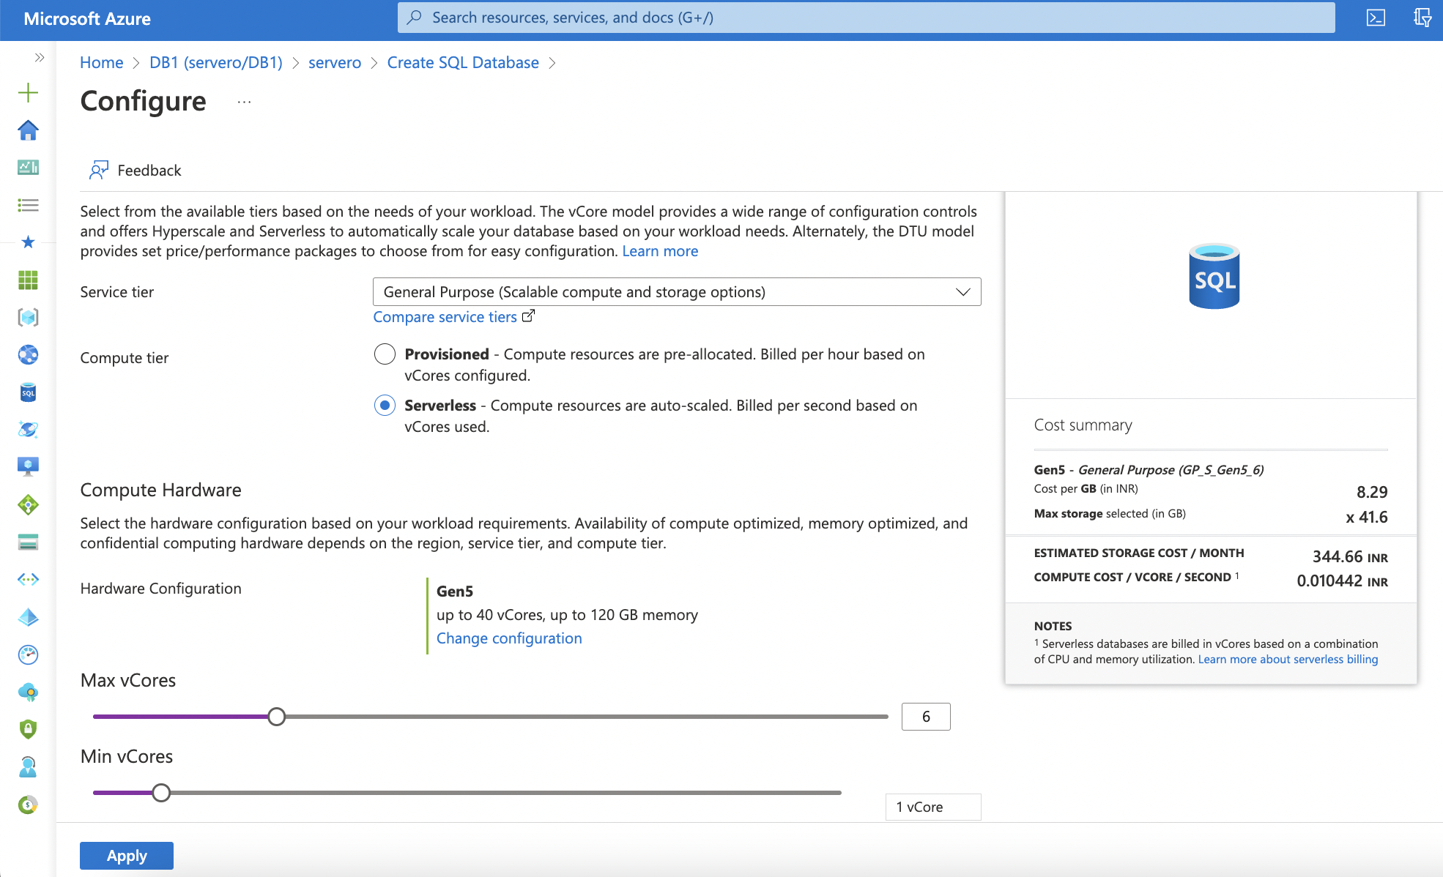
Creation of Single Database

Slide 37
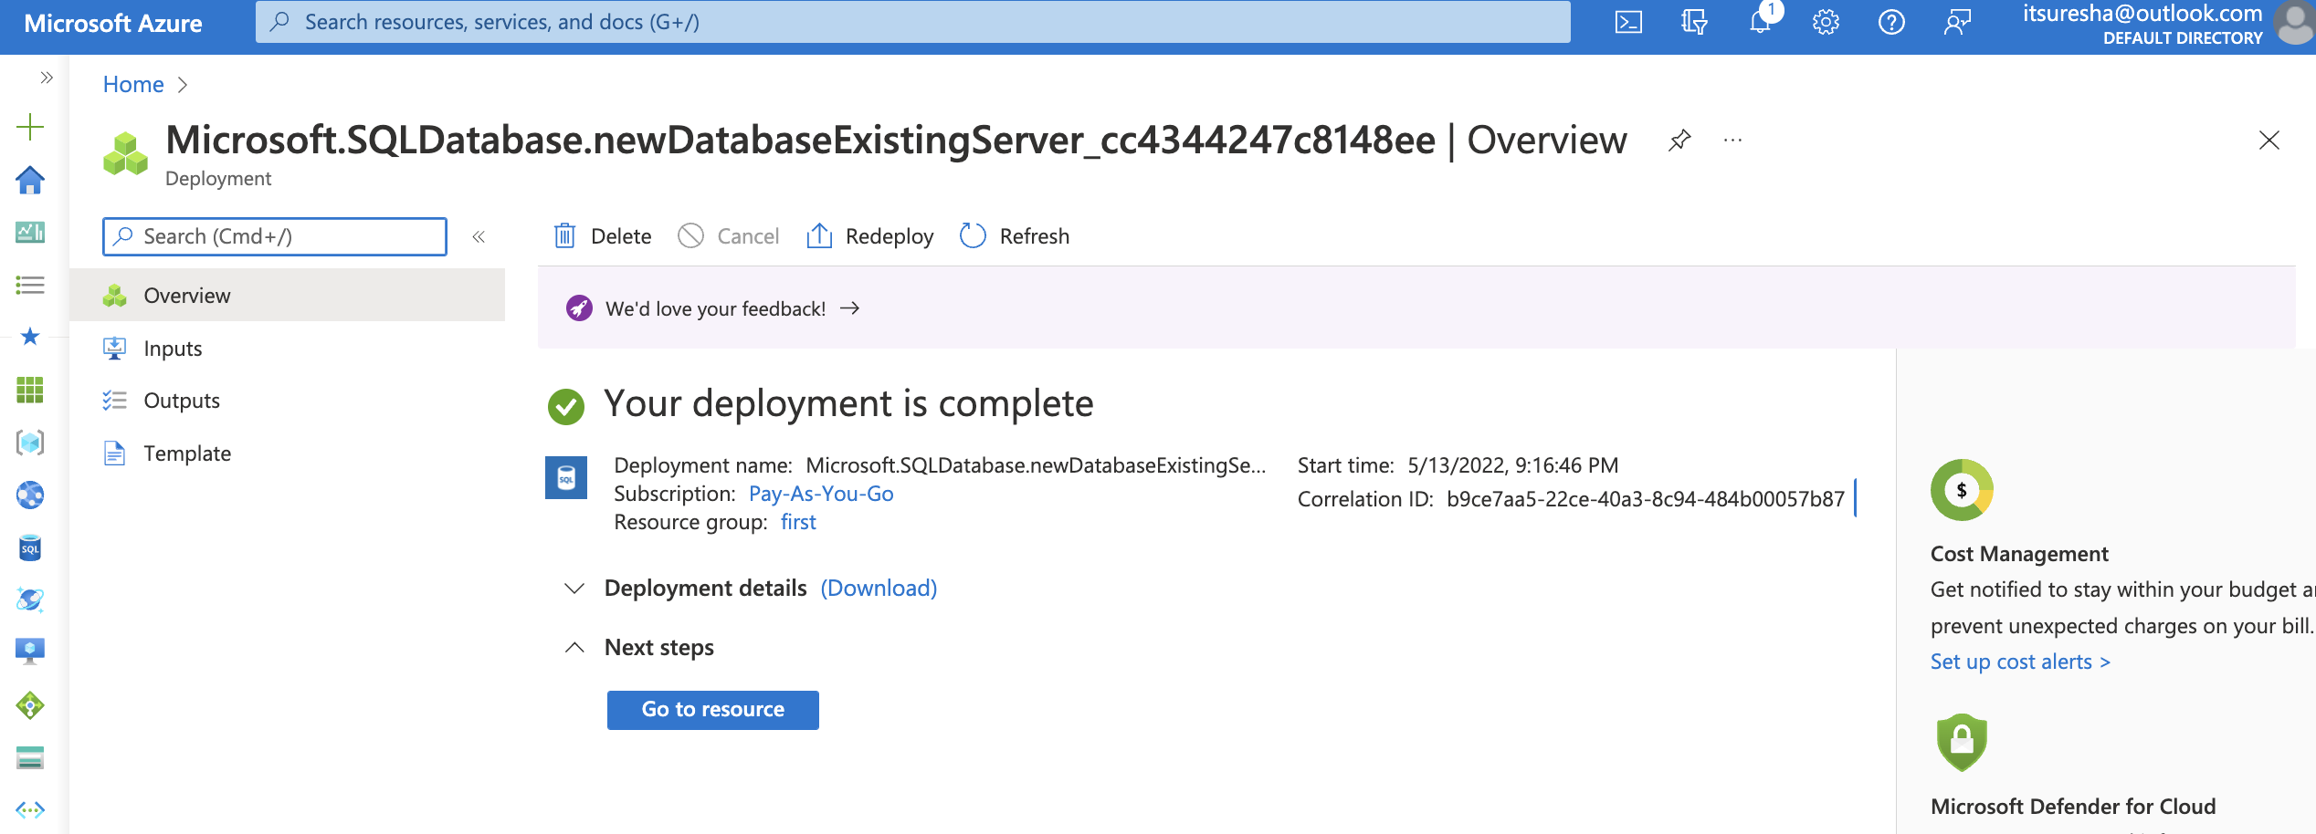
Creation of Single Database

Slide 38
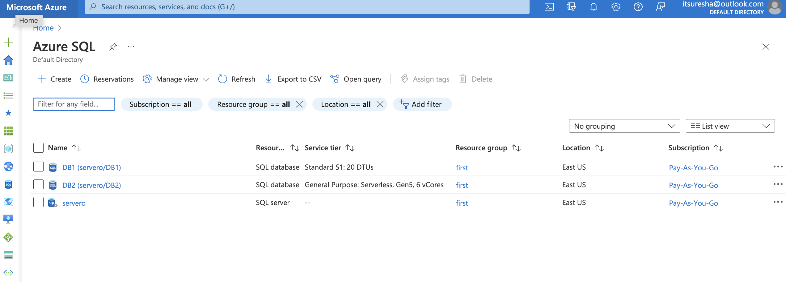
Creation of Single Database

Slide 39
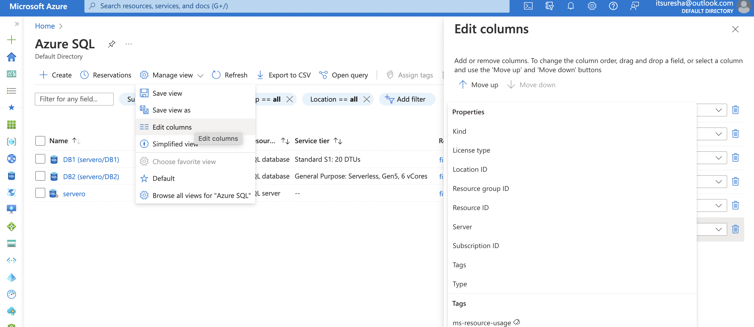
Creation of Single Database

Slide 40
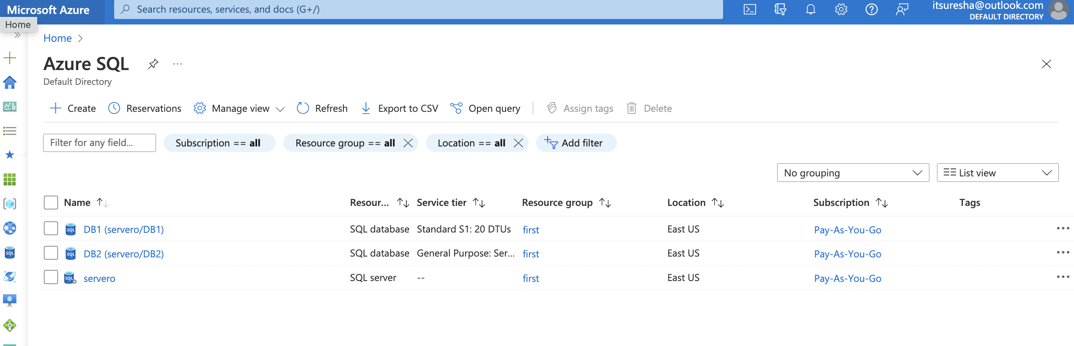
Creation of Single Database

Slide 41
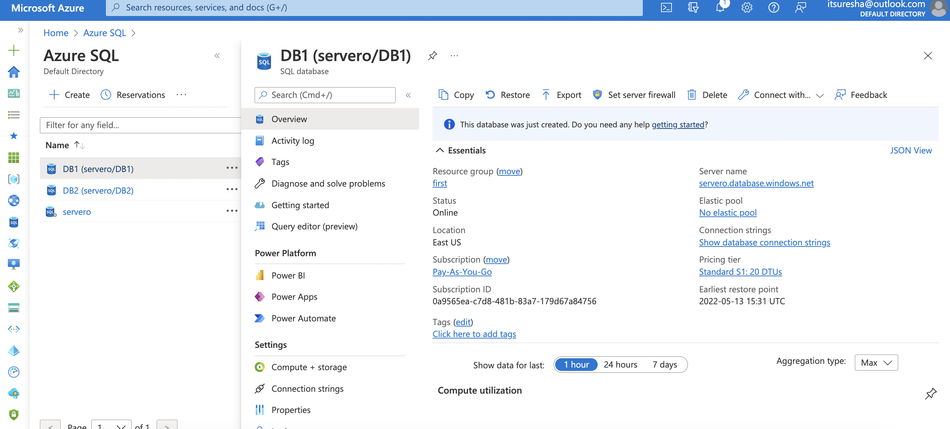
Creation of Single Database

Slide 42
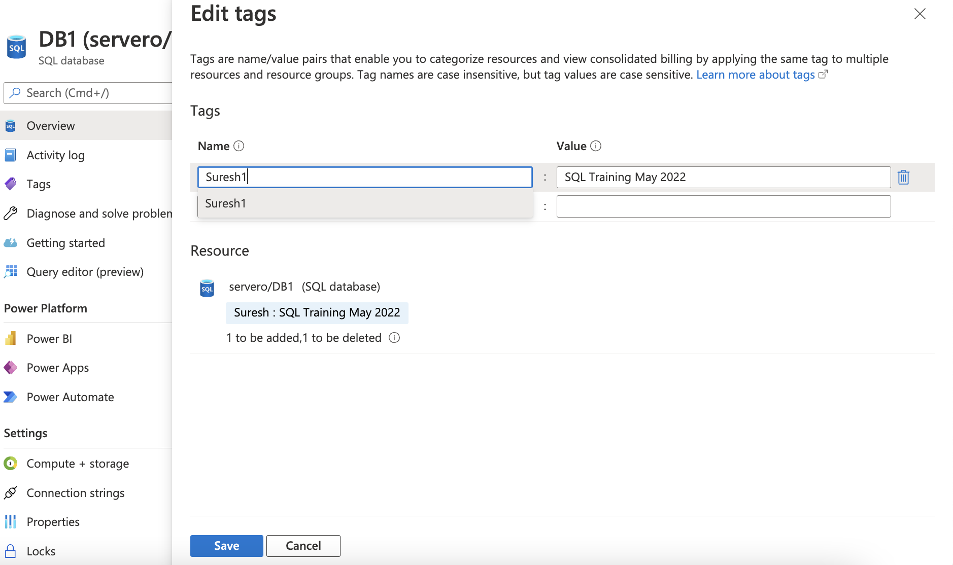
Creation of Single Database

Slide 43
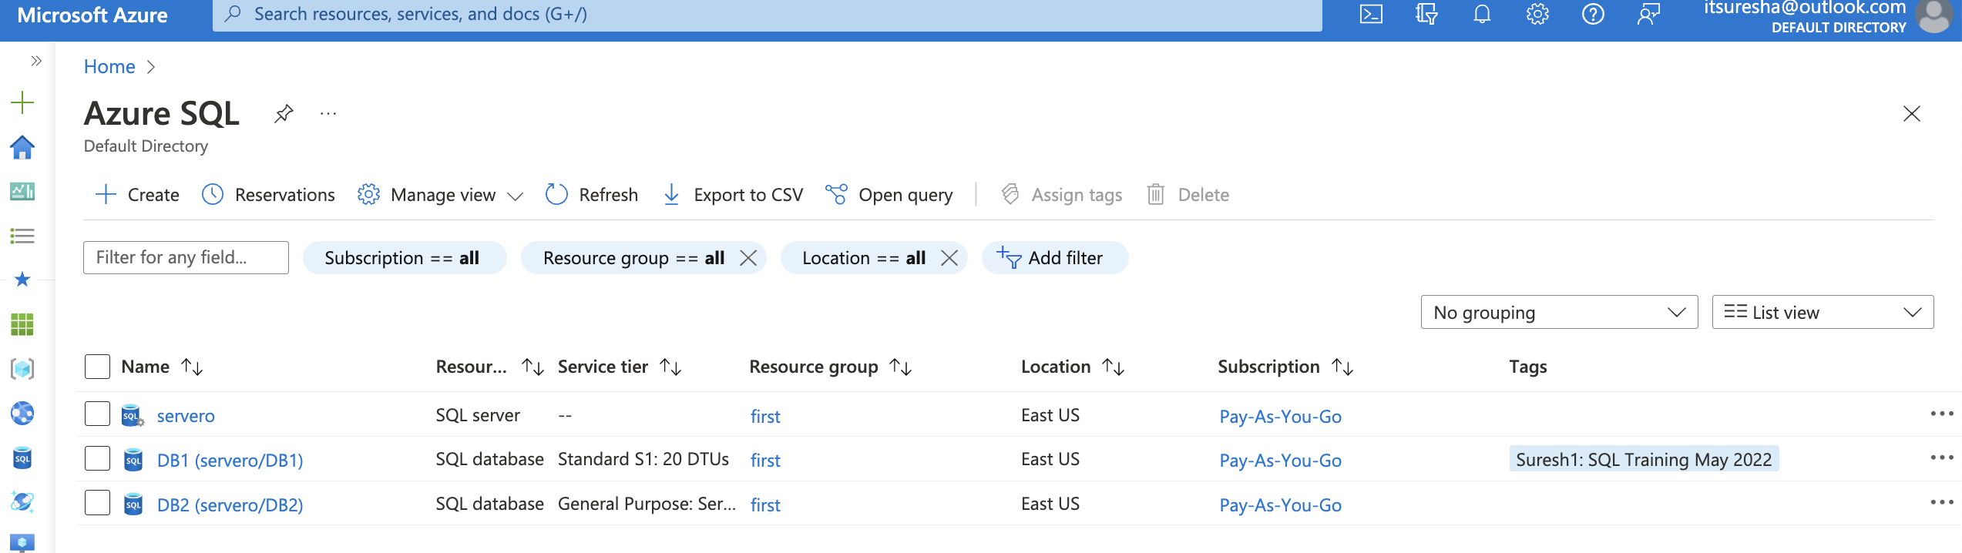
Creation of Single Database

Slide 44
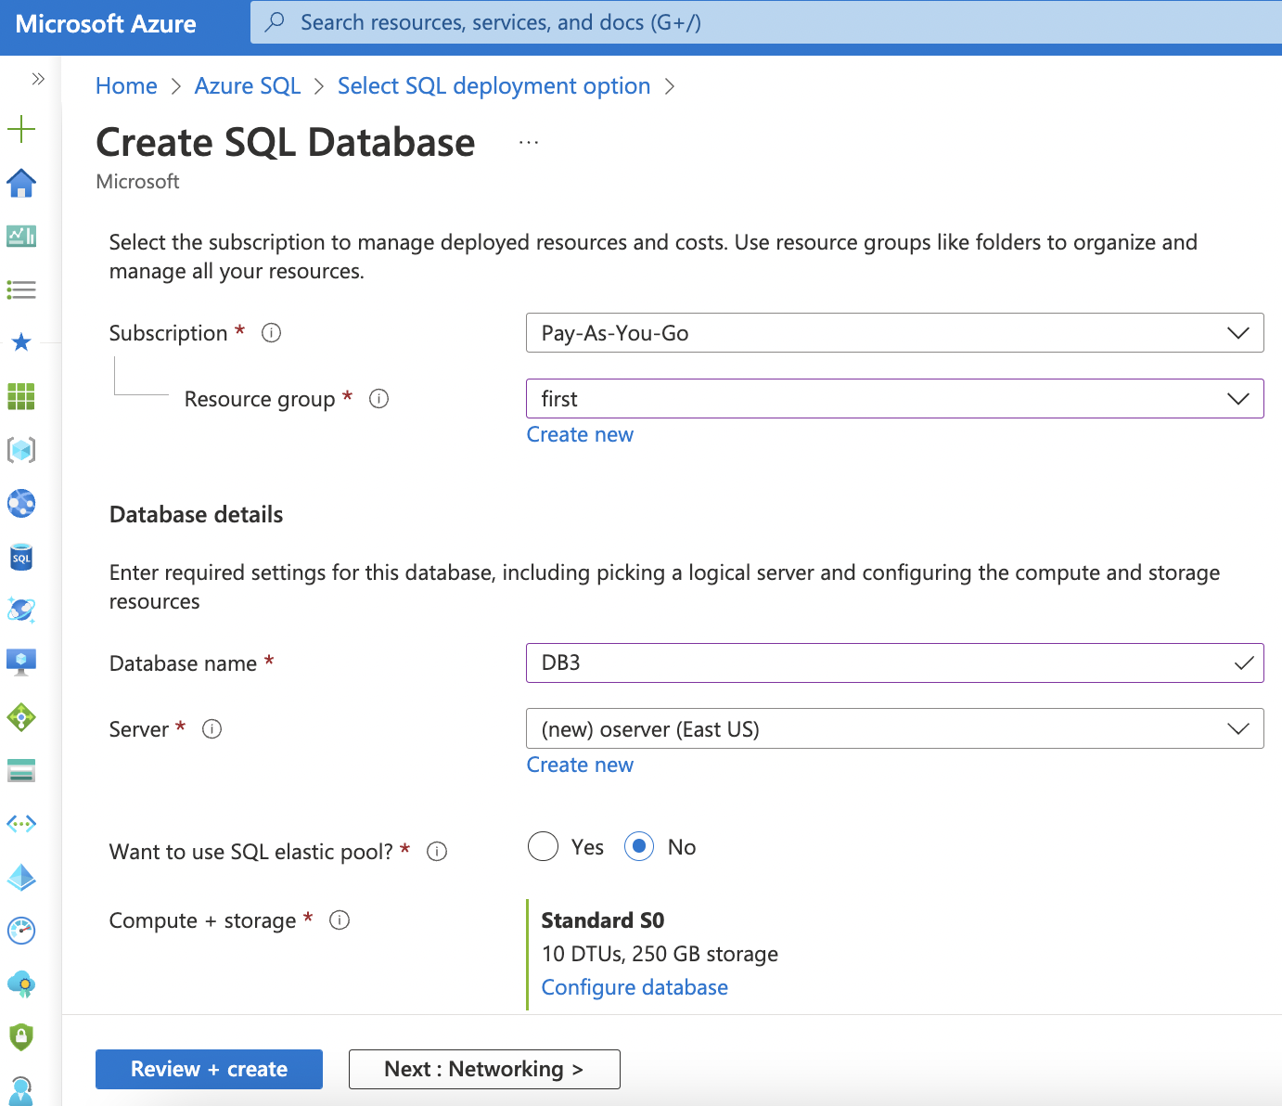
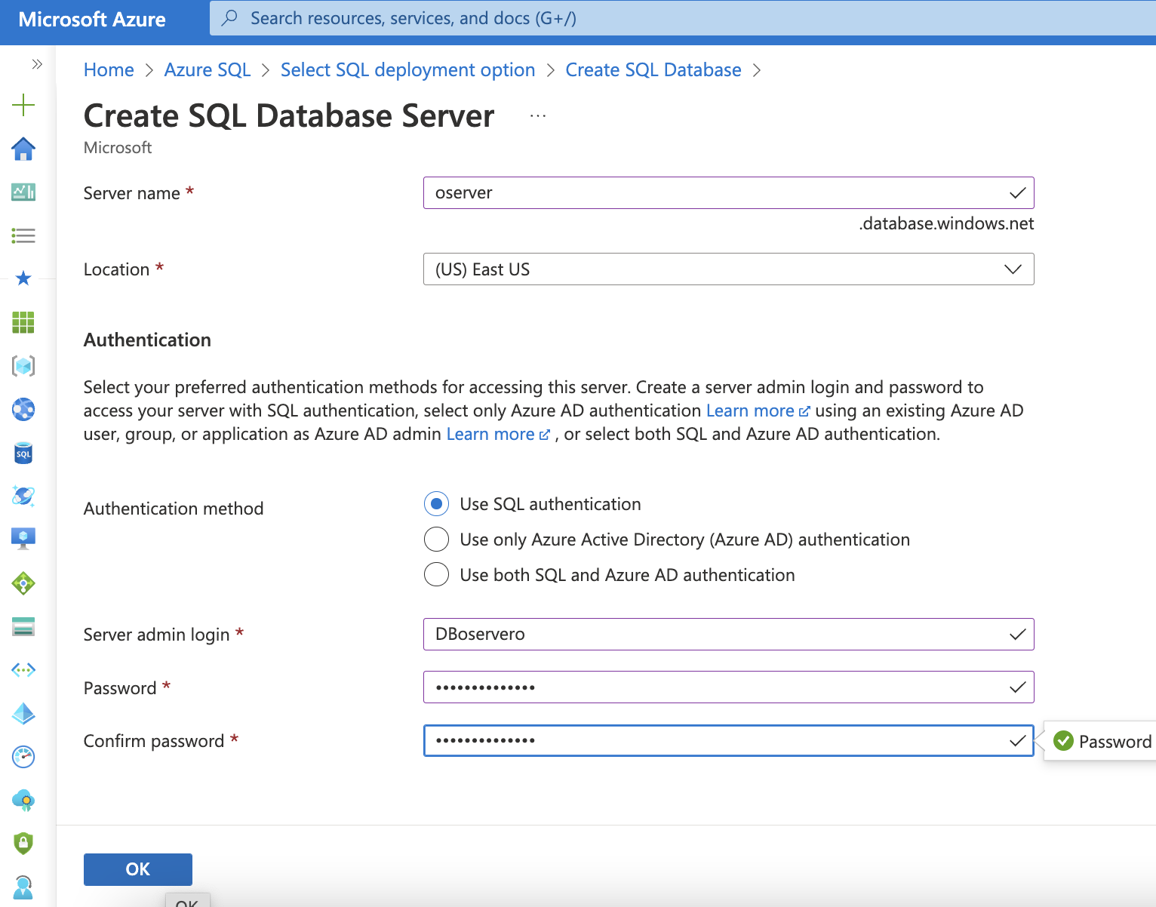
Creation of Single Database

Slide 45
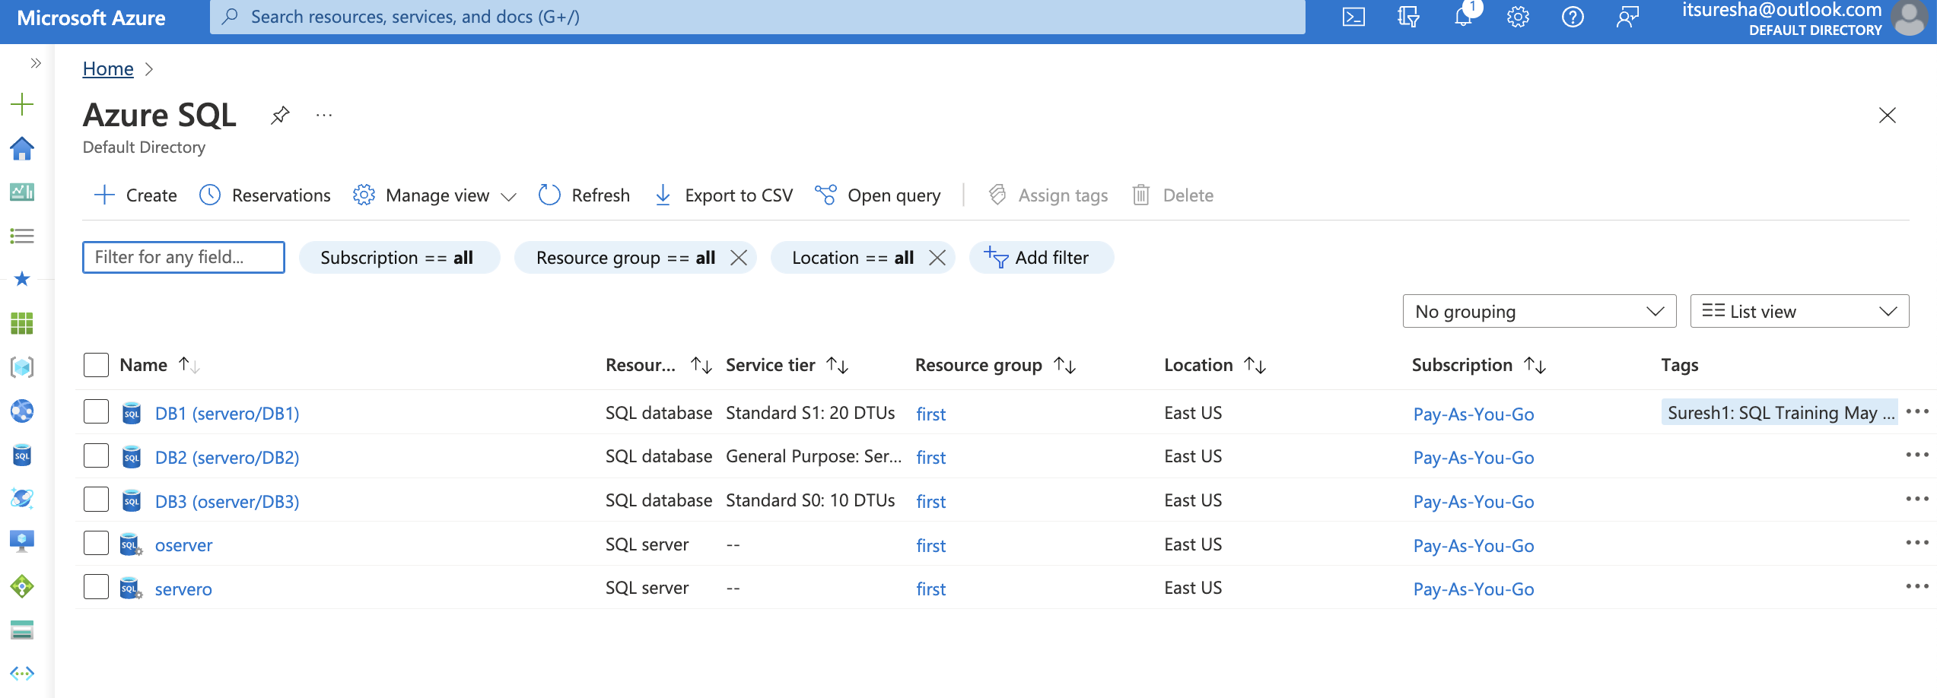
Creation of Single Database

Slide 46
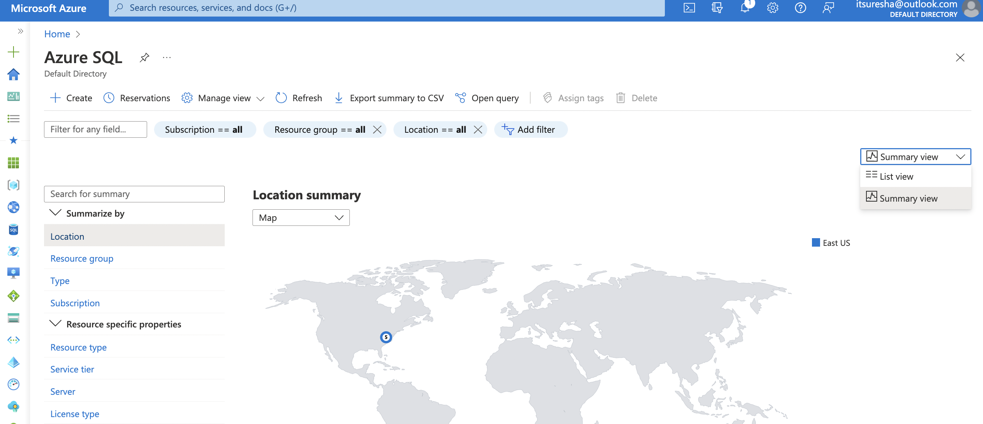
Creation of Single Database

Slide 47
Azure Database Elastic Pool
Azure Database Offerings
PaaS
IaaS
Single Database
Elastic Pool Database
Managed Instance
SQL Server hosted on VM

Slide 48
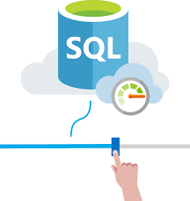
Azure SQL Database Elastic Pool
An Azure SQL Elastic Pool allows you to allocate a shared set of compute resources to a collection of Azure SQL databases

Slide 49
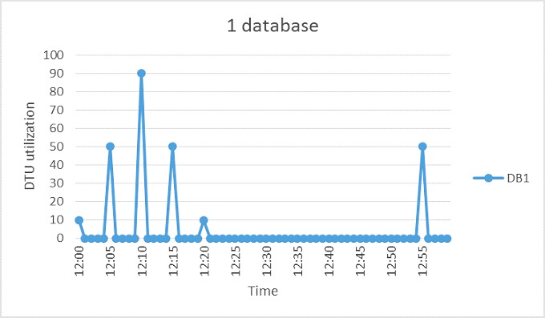
Azure SQL Database Elastic Pool

Slide 50
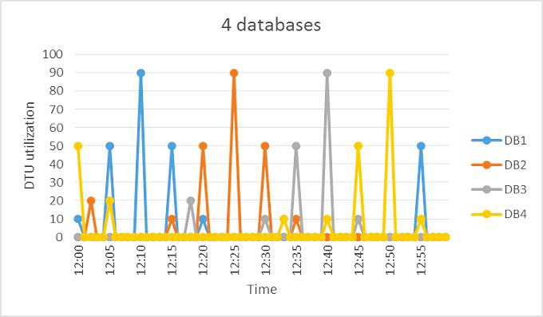
Azure SQL Database Elastic Pool

Slide 51

Azure SQL Database Elastic Pool

Slide 52




Azure SQL Database Elastic Pool
So Azure SQL elastic pool is a cost- effective solution for managing and scaling
multiple databases that have varying and unpredictable usage demands.
The databases in an elastic pool are on a single Azure SQL Database server and share a set number of resources at a set price.
Elastic pool enables developers to optimize the price performance for a group
of databases within a prescribed budget.
Elastic pools prevent over-provisioning or under-provisioning of resources.

Slide 53

Creation of Elastic Pool

Slide 54


Creation of Elastic Pool

Slide 55

Creation of Elastic Pool

Slide 56

Creation of Elastic Pool

Slide 57

Creation of Elastic Pool

Slide 58

Creation of Elastic Pool

Slide 59

Creation of Elastic Pool

Slide 60

Creation of Elastic Pool

Slide 61

Creation of Elastic Pool

Slide 62

Creation of Elastic Pool

Slide 63

Azure SQL Database Scaling
Azure SQL Database supports two types of scaling:
Vertical scaling: Scale up or down the database by adding more compute power
Horizontal scaling: Scale out or Add more databases and to shard your data into multiple database nodes

Slide 64
Vertical vs Horizontal Scaling
Azure SQL Database supports two types of scaling:
Vertical scaling:
Scale up or down the database by adding more compute power.
CPU Power, Memory, IO throughput, and storage
DTU and vCore models to scale
Dynamic Scalability (Note: this is not auto-scale)
Any change that you made will be almost instant .
Horizontal scaling: Scale out or Add more databases and to shard your data into multiple database nodes.

Slide 65

Azure SQL Database Scaling
Read Scale Out
Allows you to use the capacity of the read-only replicas for read-only queries.
Feature is intended for the applications that include logically separated read-only workloads, such as analytics
Benefit: When Secondary nodes handles heavy reports and analytical queries, primary writable node saved resources that
might be used to improve the performance
Secondary nodes is asynchronous
Premium ( DTU-based model ) or in the Business Critical ( vCore-based model)
Also available in Hyperscale with secondary replica creation
Global Scale-out/Sharding
Split your data into multiple database nodes.
Every database shard is an independent database where you can add or remove resources as needed.
Application may access only the shard associated to that region without affecting other shards.
Why?
Data or transaction throughput exceed the capabilities of individual database
Tenants may require physical isolation
Different sections of a database may need to reside in different geographies for compliance, performance, or geopolitical reasons.

Slide 66
Azure SQL Database Scaling
Change Service Tier
From Standard/General Purpose to Premium/Business Critical.
In Standard/General Purpose - Data stored on Azure premium disks
In Premium/Business Critical - Data stored on local SSD

Slide 67

Azure SQL Database Scaling

Slide 68

Azure SQL Database Scaling

Slide 69

Azure SQL DB – HA and DR Options
Region A
Region B (Read)
Storage Clusters
Each cluster is physically separate in what's called an availability zone, with its own separate utilities and networking.
Region B
Hundreds of miles away from the primary region to prevent data loss in the event of a natural disaster.

Slide 70


Azure SQL DB – High Availability Architecture
Standard availability model
Separation of compute and storage
Performance degradation during maintenance activities
Budget-oriented business applications
Basic, Standard, and General Purpose service tier availability
Premium availability model
Integrates compute resources and storage (locally attached SSD) on a single node
Replicating both compute and storage to additional nodes creating a three to four-node cluster.
Data is synchronized to at least one secondary replica before committing each transaction.
Targets mission critical applications with high IO performance and high transaction rate
Guarantees minimal performance impact during maintenance activities.
Premium and Business Critical service tier availability
Read Scale-Out feature

Slide 71

Azure SQL DB –Zone Redundancy
Zone redundant configuration
Place different replicas of the Business Critical database to different availability zones in the same region
Does not create additional database redundancy
Enable it at no extra cost
Supported in the Premium and Business Critical service tiers
Not available in SQL Managed Instance.
Increased network latency may increase the commit time and thus impact the performance of some OLTP workloads.

Slide 72

Azure SQL DB – Scalability

Slide 73

Azure SQL DB – Scalability

Slide 74

Azure SQL DB – Scalability

Slide 75











1
Backup Frequency
Full Backup
Backs up the whole database
Taken every week
2
Differential backup
Backup Frequency
Captures only the data that has changed since the last full backup
Taken every 12 hours
3
Transaction log backup
Records of all the committed and uncommitted transactions
Taken every 5-10 mins

Slide 76

Backup Frequency - Use Cases

Slide 77

Recover Deleted DB

Slide 78

Recover Deleted DB

Slide 79

Recover Deleted DB

Slide 80

Recover Deleted DB

Slide 81

Recover Deleted DB

Slide 82

Recover Deleted DB

Slide 83

Recover Deleted DB

Slide 84

Recover Deleted DB

Slide 85

Recover Deleted DB

Slide 86

Recover Deleted Table/Row

Slide 87

Recover Deleted Table/Row

Slide 88

Recover Deleted Table/Row

Slide 89

Recover Deleted Table/Row

Slide 90

Recover Deleted Table/Row

Slide 91

Recover Deleted Table/Row

Slide 92


Recover Deleted Table/Row

Slide 93

Recover Deleted Table/Row

Slide 94

Recover Deleted Table/Row

Slide 95

Long Term Backup

Slide 96

Long Term Backup

Slide 97

Long Term Backup

Slide 98

IaaS – Azure SQL

Slide 99


IaaS – Azure SQL

Slide 100

IaaS – Azure SQL

Slide 101

Resource Deletion

Slide 102


Q&A ?

